Slide 1
Shorter settlement cycles with DLTs: What consequences for liquidity? by F. Vacirca, A. Pinna and S. Rosati
Discussion

Slide 2
The study
DLT may allow DISINTERMEDIATION in securities settlement and lead to STRAIGHT THROUGH PROCESSING or even immediate T+0 settlement
Fine, but…
Primary question: the impact on liquidity needs? (cash and securities)
Future questions: The impact on risks? Could DLT features mitigate possible adverse effects?

Slide 3
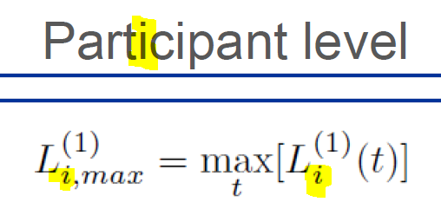
The method
10 days of trading data combined with simulated settlement cycles of increasing frequency
A big array of indicators for liquidity need and it’s concentration. One example:
L_{i}⁽¹⁾: Remaining intraday liquidity need (varies throughout the day over time)
L_{i}⁽²⁾: Peak intraday liquidity need
L⁽¹⁾: Total of aggregate remaining needs
as a fraction of
aggregate of peak liquidity needs
The peak value in system level per each day

Slide 4
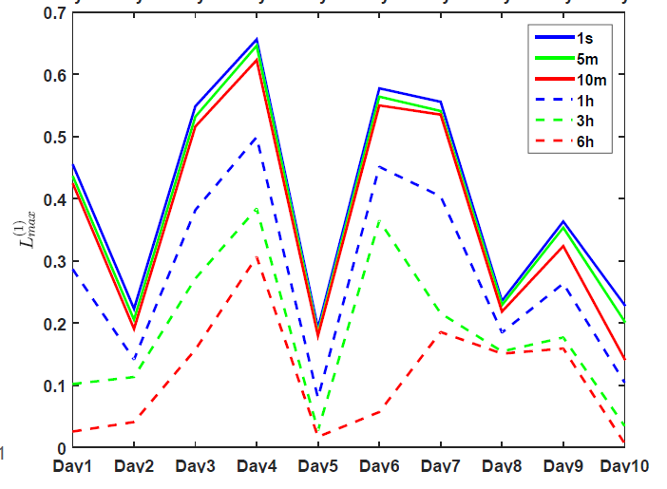
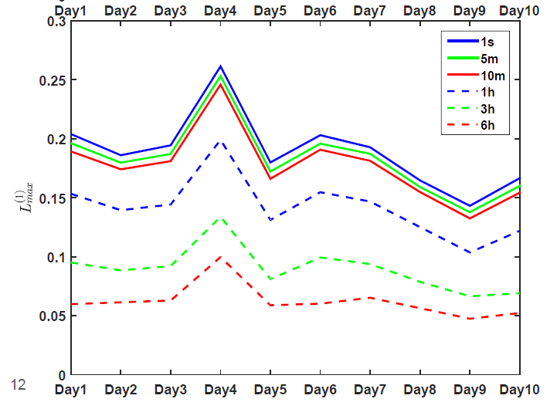
Key results
Increasing settlement frequency pushes up the liquidity needs
Liquidity needs increase clearly more for cash than securities (??)
Extra liquidity needs are rather evenly distributed except with low liquidity cases
Cash Securities

Slide 5
Comments
DLT could enable shorter settlment cycle – but it does not enforce it
We focus on the “the possibility of giving customers the choice of how fast they want to settle.” - Blythe Masters, CEO , Digital Asset Holdings
“I can even think that we [..] allow participants to select the pace at which they want to settle, which has been challenging to do in the market today.” - Fredrik Voss, the Vice President of Blockchain Innovation at Nasdaq
the Moscow Stock Exchange reverted in March 2013 from a T+0 (same day) to a T+2 settlement cycle to reduce transaction costs related to inventory management
See ‘Smart’ Settlement M. Khapko and M. Zoican
https://papers.ssrn.com/sol3/papers.cfm?abstract_id=2881331

Slide 6
Some questions
Data was trade and settlement instructions – is the latter info used?
Why is liquidity need increased more for cash, while
it can be recycled between settlement of other asset classes
Other asset classes move from T+2 into T+0, cash had RTGS before
The heap of virtually similar indicator names confuses the reader…
Any chance to use standard indicators coined in litterature or more distinct descriptive names?
What are the really relevant indicators?
Is a DLT really compatible with netting cycles (i.e. multilateral LSM)
” At its heart, there exists a fundamental inconsistency between a centralized wholesale interbank payment system and the decentralization inherent in DLT” - Carolyn Wilkins, Senior Deputy Governor of the Bank of Canada

