Slide 1
Cryptocurrencies from an Austrian perspective https://papers.ssrn.com/sol3/papers.cfm?abstract_id=2946160
Alistair Milne, Loughborough University
Presentation at BOF-Payment Simulator Seminar
Aug 31st, 2017

Slide 2
Start of a substantial research project
The paper on SSRN: proposes a radical reform of monetary arrangements
Only initial work, likely multiple outputs: book, book chapters, journal papers
Presentation today:
Part 1: from the paper
A short review of cryptocurrencies & distributed ledger
The proposal: final payment without settlement
  eliminating bank runs/ fundamentally altering ‘lender of last resort’
(Paper also argues that this can help achieve Austrian monetary objectives – disengaging the state from intervention in financial sector, taming credit cycles)
Part 2: going beyond the paper (short further notes available)
Implications for quantitative modelling of money markets and payments flows

Slide 3
Part 1
Overview of cryptocurrencies and the policy proposal

Slide 4
Table 1: the leading cryptocurrencies
Rank | Name | Date of launch | Ticker | Market Capitalisation
 |  |  |  | US dollars | Percent
1 | Bitcoin | Jan, 2009 | BTC | $18,774,053,810 | 84.66%
2 | Ethereum | Aug, 2015 | ETH | $1,529,262,607 | 6.90%
3 | Dash | Jan, 2014 | DASH | $306,741,545 | 1.38%
4 | Ripple | Sep, 2014 | XRP | $244,556,871 | 1.10%
5 | Litecoin | Oct, 2011 | LTC | $190,232,580 | 0.86%
6 | Monero | Apr, 2014 | XMR | $177,583,908 | 0.80%
7 | Ethereum Classic | Jul, 2016 | ETC | $115,647,290 | 0.52%
8 | NEM | Mar, 2015 | XEM | $83,963,700 | 0.38%
9 | MaidSafeCoin | Apr, 2014 | MAID | $63,237,411 | 0.29%
10 | Augur | Oct, 2015 | REP | $58,390,090 | 0.26%

Slide 5
Key points (more detail in paper Appendix A)
Cryptocurrency technologies are fascinating
  but usage is niche and not always legal
Key features:
  decentralised, encrypted, unpermissioned, supported by open source software,
No prospect of substituting for established nation state currencies
  Not least because of governance problems
Should central banks issue their own ‘cryptocurrencies’?
  Weak case in terms of improving payments services
  Related issue: non-banks access to central bank liabilities
    supporting competition in payment and transaction services
    but this is different, can be achieved with conventional technology not crypto
  Other rationales? Perhaps yes e.g. client asset segregation.
  Also a case on broader macroeconomic and prudential grounds (my proposal)
Widespread interest in the technology of ‘mutual distributed ledgers’ aka ‘blockchain’ underpinning cryptocurrencies

Slide 6
The proposal ‘Fiatcoin’

Slide 7
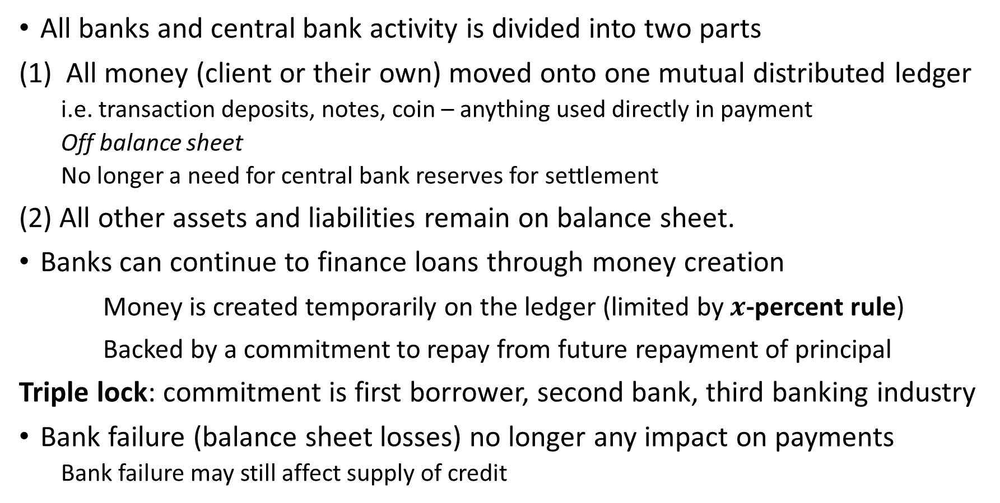
In summary
All banks and central bank activity is divided into two parts
All money (client or their own) moved onto one mutual distributed ledger
  i.e. transaction deposits, notes, coin – anything used directly in payment
  Off balance sheet
  No longer a need for central bank reserves for settlement
(2) All other assets and liabilities remain on balance sheet.
Banks can continue to finance loans through money creation
Money is created temporarily on the ledger (limited by $x$-percent rule)
Backed by a commitment to repay from future repayment of principal
Triple lock: commitment is first borrower, second bank, third banking industry
Bank failure (balance sheet losses) no longer any impact on payments
  Bank failure may still affect supply of credit

Slide 8
Figure 1: fractional reserved banking with central bank settlement

Slide 9
Figure 3: fractional reserved banking without settlement

Slide 10
Standard cryptocurrency ledger (e.g. Bitcoin blockchain), only does one thing, credit only transactions.

Slide 11
The proposal: a state-sponsored ledger, containing fiat (state issued) money, bank money & money-financed bank loans. Banks can freely create money but are committed to repay in the future at a stated time. ‘Smart contracts’ (or as I prefer to call them dumb contracts) used to ensure repayment.

Slide 12
This eliminates bank runs
Credit safe money held in a (possibly bank-operated) crypto safe
Clearly distinguished from credit risky deposits (intraday?, overnight or term) to a bank or other financial or non-financial institutions
No more ‘sequential order constraint’
  So no possibility of a bank run
  But banks can still suffer liquidity problems (inability to refinance borrowing)
Need for rethinking ‘lender of last resort’
  No longer needed to stem bank runs
  But loss of confidence may still result in a self-reinforcing withdrawal of liquidity from money markets

Slide 13
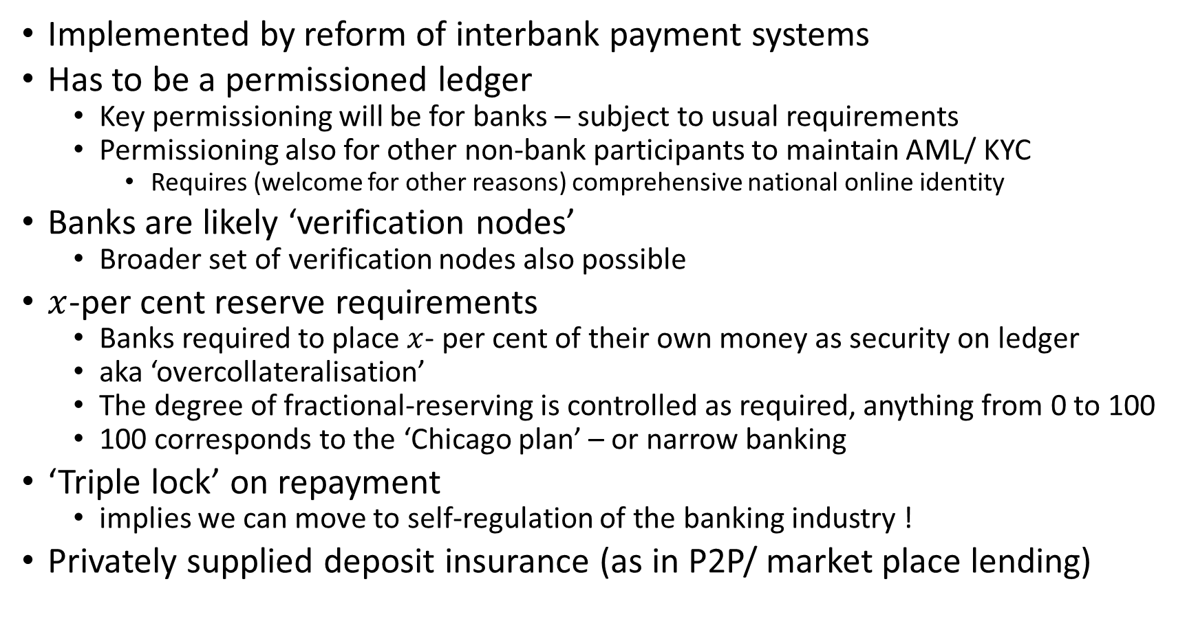
The proposal - continued
Implemented by reform of interbank payment systems
Has to be a permissioned ledger
  Key permissioning will be for banks – subject to usual requirements
  Permissioning also for other non-bank participants to maintain AML/ KYC
    Requires (welcome for other reasons) comprehensive national online identity
Banks are likely ‘verification nodes’
  Broader set of verification nodes also possible
$x$-per cent reserve requirements
  Banks required to place $x$- per cent of their own money as security on ledger
  aka ‘overcollateralisation’
  The degree of fractional-reserving is controlled as required, anything from 0 to 100
  100 corresponds to the ‘Chicago plan’ – or narrow banking
‘Triple lock’ on repayment
  implies we can move to self-regulation of the banking industry !
Privately supplied deposit insurance (as in P2P/ market place lending)

Slide 14
Part 2
Additional: Implications for money markets and simulation modelling of payments flows
(Preliminary work. Not in paper. See supplementary notes.)

Slide 15
Uncertainty in payments flows
From inter alia:
Settlement of securities and money market trades (equities, bonds, bills, and other instruments.
Capital inflows/ outflows, from forex markets
Government receipts, seasonal
Other season flows (agriculture, Xmas).
All uncertain, at entire frequency range intra-day to medium term
Challenge of ensuring sufficient medium of exchange to support these flows.

Slide 16
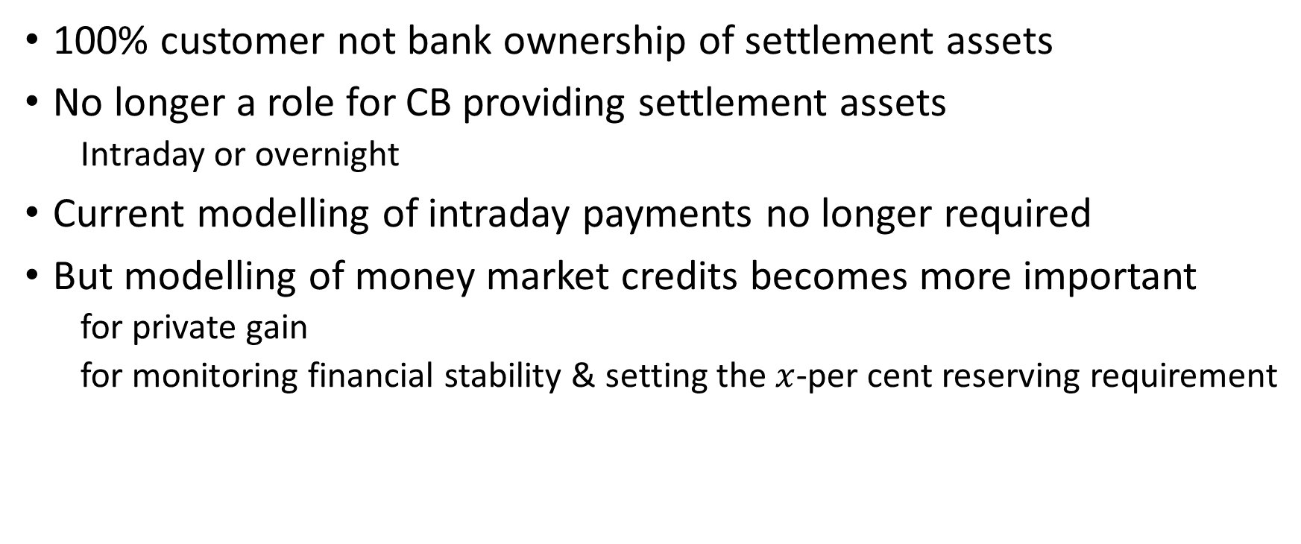
Implications of ‘fiatcoin’
100% customer not bank ownership of settlement assets
No longer a role for CB providing settlement assets
  Intraday or overnight
Current modelling of intraday payments no longer required
But modelling of money market credits becomes more important
  for private gain
  for monitoring financial stability & setting the $x$-per cent reserving requirement

Slide 17
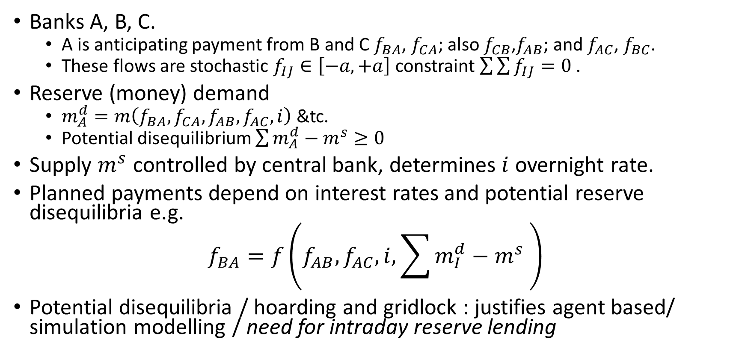
A schemata of current modelling
Banks A, B, C.
  A is anticipating payment from B and C $f_{BA}$, $f_{CA}$; also $f_{CB}$,$f_{AB}$; and $f_{AC}$, $f_{BC}$.
  These flows are stochastic $f_{IJ}∈\left[−a,+a\right]$ constraint $\sum{\sum{f_{IJ}=0}}$ .
Reserve (money) demand
  $m_{A}^{d}=m\left(f_{BA}, f_{CA},f_{AB},f_{AC},i\right)$ &tc.
  Potential disequilibrium $\sum{m_{A}^{d}}−m^{s}≥0$
Supply $m^{s}$ controlled by central bank, determines $i$ overnight rate.
Planned payments depend on interest rates and potential reserve disequilibria e.g.
$$f_{BA}=f\left(f_{AB},f_{AC},i,\sum{m_{I}^{d}}−m^{s} \right)$$
Potential disequilibria / hoarding and gridlock : justifies agent based/ simulation modelling / need for intraday reserve lending

Slide 18
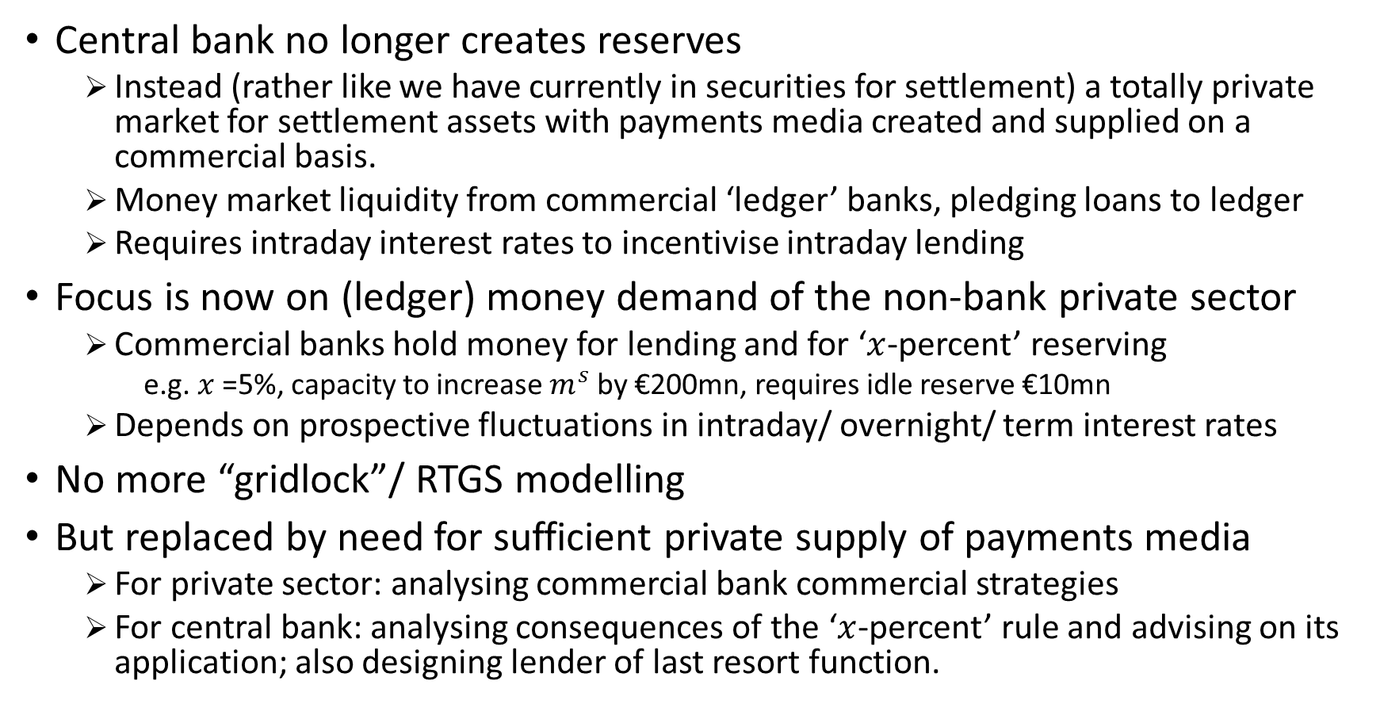
Under proposal …
Central bank no longer creates reserves
  Instead (rather like we have currently in securities for settlement) a totally private market for settlement assets with payments media created and supplied on a commercial basis.
  Money market liquidity from commercial ‘ledger’ banks, pledging loans to ledger
  Requires intraday interest rates to incentivise intraday lending
Focus is now on (ledger) money demand of the non-bank private sector
  Commercial banks hold money for lending and for ‘$x$-percent’ reserving
    e.g. $x$=5%, capacity to increase $m^{s}$ by €200mn, requires idle reserve €10mn
  Depends on prospective fluctuations in intraday/ overnight/ term interest rates
No more “gridlock”/ RTGS modelling
But replaced by need for sufficient private supply of payments media
  For private sector: analysing commercial bank commercial strategies
  For central bank: analysing consequences of the ‘$x$-percent’ rule and advising on its application; also designing lender of last resort function.

Slide 19
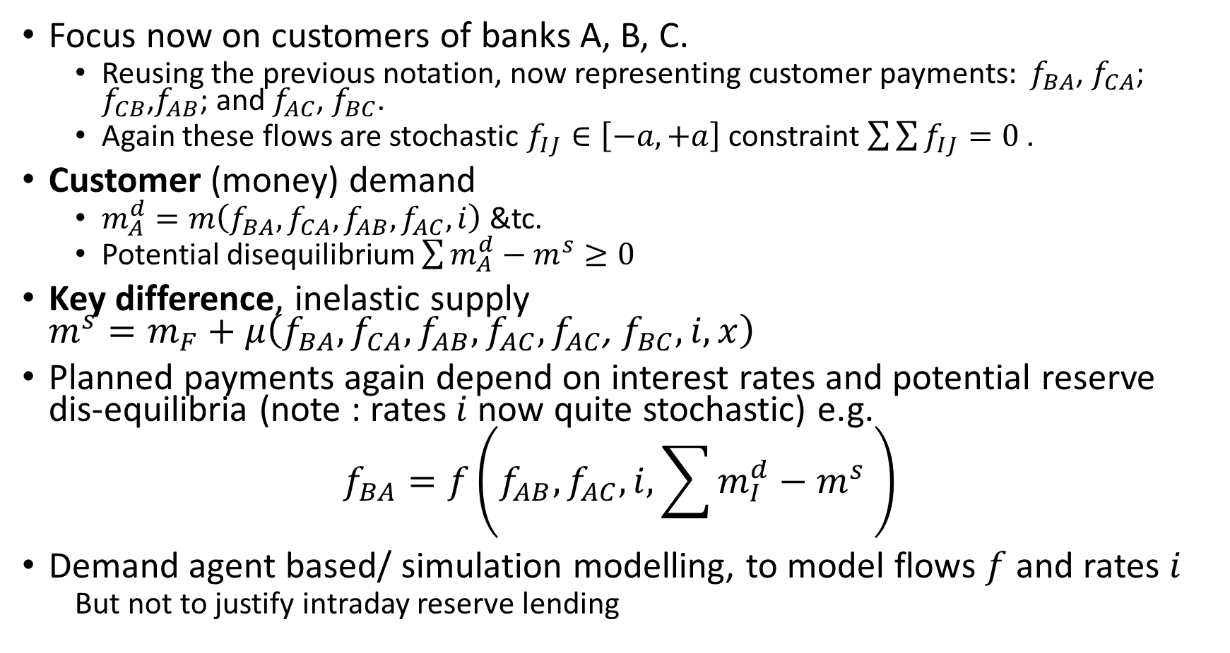
A new modelling schemata
Focus now on customers of banks A, B, C.
  Reusing the previous notation, now representing customer payments$: f_{BA}$, $f_{CA}$; $f_{CB}$,$f_{AB}$; and $f_{AC}$, $f_{BC}$.
  Again these flows are stochastic $f_{IJ}∈\left[−a,+a\right]$ constraint $\sum{\sum{f_{IJ}=0}}$ .
Customer (money) demand
  $m_{A}^{d}=m\left(f_{BA}, f_{CA},f_{AB},f_{AC},i\right)$ &tc.
  Potential disequilibrium $\sum{m_{A}^{d}}−m^{s}≥0$
Key difference, inelastic supply $m^{s}=m_{F}+μ\left(f_{BA}, f_{CA},f_{AB},f_{AC},f_{AC}\text{, }f_{BC},i,x\right)$
Planned payments again depend on interest rates and potential reserve dis-equilibria (note : rates $i$ now quite stochastic) e.g.
$$f_{BA}=f\left(f_{AB},f_{AC},i,\sum{m_{I}^{d}}−m^{s} \right)$$
Demand agent based/ simulation modelling, to model flows $f$ and rates $i$
  But not to justify intraday reserve lending

Slide 20
Thank you!

