Slide 1
CCP profits and losses due to clearing member failure: A simulation approach
Alinda Heemskerk, Ronald Heijmans
De Nederlandsche Bank
Kasperi Korpinen and Tatu Laine
Bank of Finland
Payment System Simulator Seminar, 31 August – 1 September 2017
Bank of Finland, Helsinki

Slide 2
I think that the people of this country have had enough of experts from organisations with acronyms saying they know what is best and getting it consistently wrong.
Quote: McGove just before the Brexit

Slide 3
What about us studying CCP?

Slide 4
Outline
Motivation
Research question(s)
Simulator and (cash) CCP
Data
Results
Volatility of the market (work in progress)
Summary

Slide 5
Motivation

Slide 6
Research questions
How to apply a simulation methodology to CCPs?
Does the CSD structure matter?
Are the initial margins and default fund contributions in line with the risks?
What is the impact of realistic but extreme stock volatility on potential losses?
Are there not too many ”black swans” that they become too likely to be found?

Slide 7
Bilateral vs CCP trading
A
A
B
E
B
CCP
E
C
D
C
D
Bilateral trading
CCP trading

Slide 8
Benefits CCP
Efficiency with CCP:
Becoming the buyer to every seller and the seller to every buyer.
Netting reduces positions.
Takes on settlement risks.
Simplifies the network structure (no gridlocks).
The use of CCPs has been widely promoted since 2009 (EMIR 2012).

Slide 9
When is the CCP at risk?
Default of clearing mebers.
Due to settlement failure , which which happens in CSD’s securities settlement systems (and T2S).
The value of the risk is determined by the prices at wich the CCP can procure securities it has to provide and collateral prices.

Slide 10
CCP simulator: Process flow in this exercise
Extension BoF PSS2.
Main CCP features.
Trade data
Risk summary
Pre - prosessing
Reporting
Simulation

Slide 11
Characteristic of the data
41 clearing members (CMs);
8 currencies;
16 CSDs;
> 4000 ISINs;
15 trading days;
± 2000 billion euro/day;
± 3.3 million trades/day;
± EUR 600.000 euro/transaction.

Slide 12
Key data features
7 large CM
Active in many markets (CSDs)
75% of total value per day
40% of CM active only Nordic market
13% of total value per day
Stress analysis only for large CMs
They are systemically important players

Slide 13
Netting performance: from many to 1 CSD
Based on data over 15 days:
Many-to-one csd (cash to Cparty): 36+/-11%
Many-to-one csd (securities to Cparty): 0.2+/-0.1%

Slide 14
Exposure of the CCP (1/2)
Settlement risk;
Price changes in securities and currencies
to be acquired by the CCP.
held by the CCP due to the failing counterparty.
Price changes in posted collateral and default fund contributions.

Slide 15
Exposure of the CCP 2/2
Gap = price of shares and currencies to be bought (t+>3)
Value of due assets to the failing participant.
Participant 1
Vectors of n shares
CCP
Failing Participant
Vectors of n Currencies
Participant 2

Slide 16
Stress scenario: Cover 1 and Cover2
Ceteris paribus price change of + 6 % for securities to be acquired by the CCP
Base contribution to the clearing fund
Direct clearing participants 24 m€
General clearing participants 60 m€
Buffer together 84m€

Slide 17
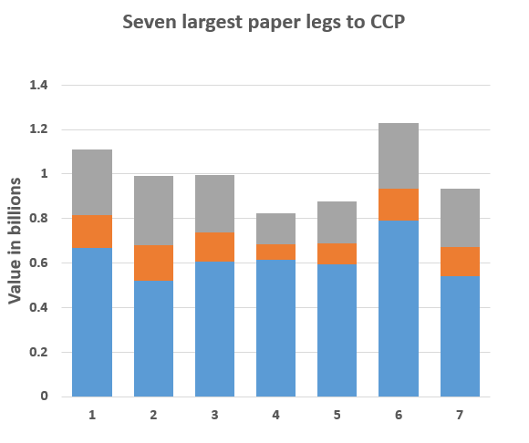
Stress scenario: Cover 1 and Cover2

Slide 18
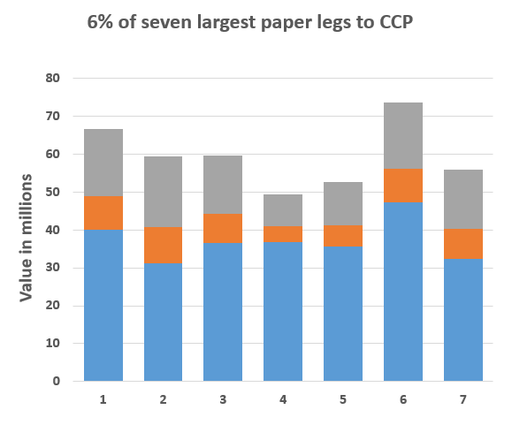
Stress scenario: Cover 1 and Cover2

Slide 19
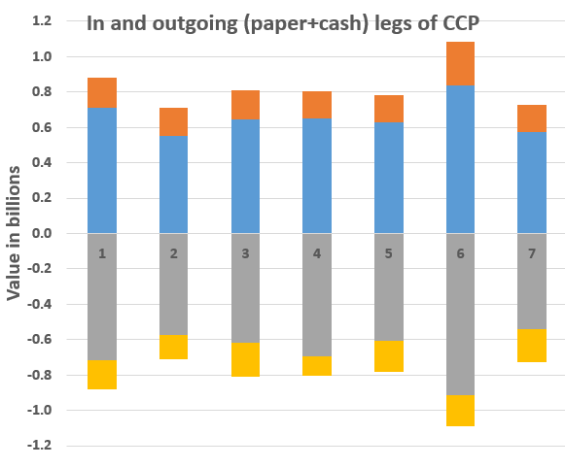
Stress scenario: Cover 1 and Cover2

Slide 20
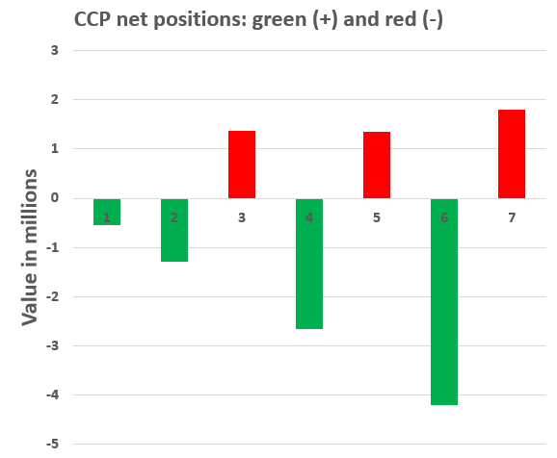
Stress scenario: Cover 1 and Cover2

Slide 21
Analyzing results
Net amounts not alarming
How about unexpected market illiquidity?
Collateral price correlations?
Actions of other CCPs?

Slide 22
Netting performance does not improve for securities positions when switching from multiple CSD’s to one CSD.
Securities are still mainly tied to national CSD. If they would be scattered, the netting performance would improve from switching to one CSD.
Netting performance does improve for cash, but only for a minority. Most of CCP counterparts do not benefit from using single cash 0accounts.

Slide 23
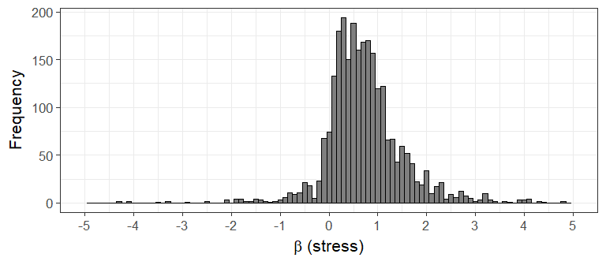
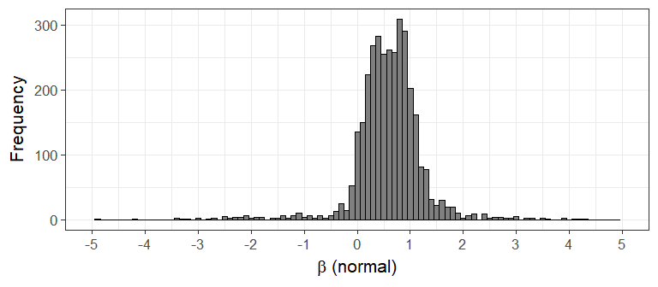
Realistic price movements in stocks
Beta picture here? Stressed vs non-stressed

Slide 24
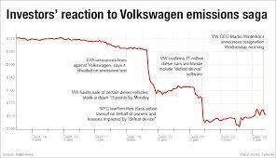
How to apply β’s (work in progress)
Some β’s can be extremely large (> 2000).
Use historical stressed and non-stressed β’s to estimate potential loss or profit by the CCP.
Use historical fluctuation as a proxy for potential estimated losses or profits by the CCP: Look for a worst case scenario.
Loss becomes huge?
Loss in same order of magnitude?

Slide 25
Summary
First time CCP data analyzed in this way.
Automating simulations in BoF-PSS2 –tool made this possible.
Exposures in realistic data reveal that few large players and many small ones.
Netting performance improves 12% when moving multiple CSDs to one CSD.
Default fund large enough for Cover 1 and Cover 2 scenarios for large participants.

