Slide 1
Discussion Critical participants in target2
Bank of Finland, 15th Payment and Settlement System Seminar, 1 September 2017

Slide 2
Summing up about critical participants
Critical participants’ operational outages can be a potential source of systemic risk
SIPS operators must identify critical participants based on turnover and potential impact
Target2 critical participants identification criteria:
generated turnover + simulated technical failure
A participant is assessed critical if
The participant’s traffic exceeds 1% of avg. daily traffic
and/or
The avg. unsettled payments due to a technical failure of the participant exceeds 1,5% of traffic
Estimated by using the Target2 simulator

Slide 3
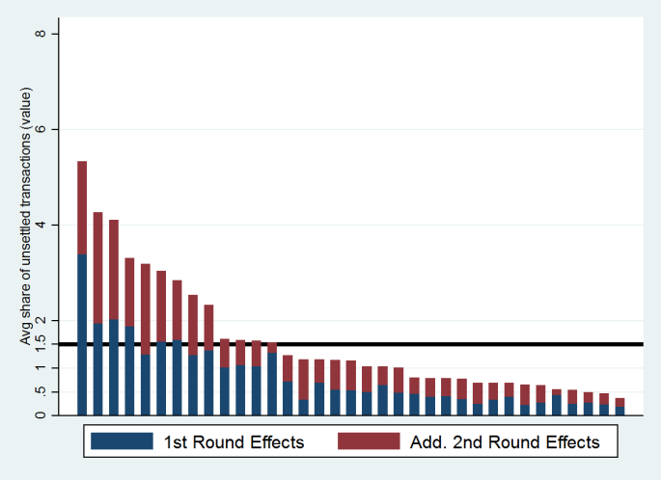
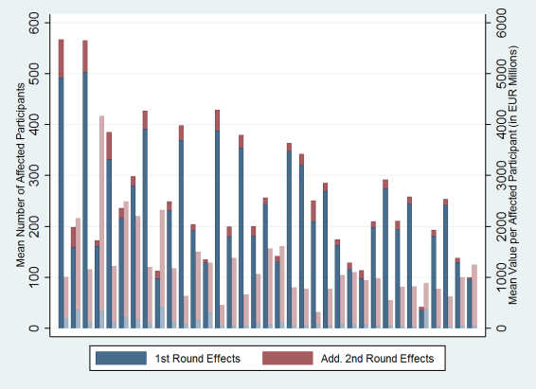
The simulation results
1st and 2nd round effects vary over participants
Participant’s size (turnover)
Network effects
Counterparty’s liquidity management
Some participants affect many others, while other participant affect fewer, but the unsettled value can still be large.
The simulations result in reclassification of participants
it is relevant!

Slide 4
Comments and questions
Inspiring presentation – I will bring back home:
New ideas of presenting simulator results
Inspiration to set up an indicator
The effect of a technical failure depends highly on the network - a natural next step to analyze (as also suggested)
Did you consider including analysis of intraday queues?
The effect intraday might be worse than the effect end of day
Simultaneous failure of two: 1+1 = 2
Do the overlap and contagion effect offset each other or are they negligible?

Slide 5
Further enhancements
Enhance the criticality indicator with a 2nd round effect parameter
captures the other participants’ ability to pay despite the missing incoming payments
Alternatively a multiplier effect (2nd round effect/1st round effect)
Worst case scenario: The day with the largest effect
Average values ”hide” heterogeneity
Use max values to determine criticality

Slide 6
Discussion points
What is the worst? To affect many a little bit or to affect few a lot?
How can we make more realistic simulations?
Assumptions, e.g. on behaviour
Combining simulation results with other analyses, e.g. network, money market

Slide 7
Thank you!

