Slide 1
The Hidden Content of Absent Transactions
An Algorithmic Approach for Identifying Participants’ Operational Outages
Marc Glowka, Payments and Settlement Systems, Deutsche Bundesbank
15th Payment and Settlement System Simulation Seminar
Helsinki, 1 September 2017

Slide 2
Disclaimer
The authors of this paper are members of one of the user groups with access to TARGET2 data in accordance with Article 1(2) of Decision ECB/2010/9 of 29 July 2010 on access to and use of certain TARGET2 data. The Deutsche Bundesbank and the MIPC have checked the paper against the rules for guaranteeing the confidentiality of transaction-level data imposed by the PSSC pursuant to Article 1(4) of the above mentioned issue. The views expressed in the paper are solely those of the authors and do not necessarily represent the views of the Eurosystem.

Slide 3
Introduction
Operational risk – the hidden risk in FMIs
Operational risks are a major source of risk for financial market infrastructures
      Principles for Financial Market Infrastructures (PFMIs):
      FMI should “identify the plausible sources of operational risk, both internal and external…For example, participants can generate operational risk for FMIs and other participants, which could result in liquidity or operational problems within the broader financial system.”
System outages of TARGET2 are well understood but in contrast less is known on participants’ (partial) operational outages
Despite a reporting obligation for operational outages of critical participants in TARGET2, until now a comprehensive data set on participants’ outages does not exists
By identifying operational outages of participants in TARGET2, we try to enlighten the dark area of participant operational outages in FMIs

Slide 4
Data
Basis, preparation and final data set
Data basis
Customer, interbank and CLS transactions
Participants with at least 0.05% of overall traffic
Cleaning for national holidays by account location and country of group parent
Aggregation to ten minutes intervals
Transactions between 7 am and 6 pm*
TARGET2 transactions from 2009 to 2016
Data preparation
Data set
187 participants
480 mil. transactions
66 ten minutes intervals per day (24 mil. in data set)
*As only certain payments are settled in night-time settlement procedures occurring between 6 pm and 7 am, we chose 6 pm as maximum entering time. Furthermore, we do not take business days with delayed closing hours into account as a general rule.

Slide 5
Identification approach
Basic approach
Contingency measures allow participants to initiate a limited number of transactions in TARGET2
The identification of intervals with zero transactions is therefore not sufficient
The approach identifies intervals, where payment activity is deemed to be so low that an operational outage may be assumed
Basic approach:
𝑉𝑜𝑙𝑢𝑚𝑒 𝑜𝑓 𝑡𝑟𝑎𝑛𝑠𝑎𝑐𝑡𝑖𝑜𝑛 𝑜𝑓 𝑎 𝑝𝑎𝑟𝑡𝑖𝑐𝑖𝑝𝑎𝑛𝑡 (𝑝) 𝑖𝑛 𝑖𝑛𝑡𝑒𝑟𝑣𝑎𝑙 (𝑖)𝑜𝑛 𝑑𝑎𝑦 (𝑑) 𝑙𝑖𝑒𝑠 𝑖𝑛 𝑓𝑖𝑟𝑠𝑡 𝑝𝑒𝑟𝑐𝑒𝑛𝑡𝑖𝑙𝑒
𝑜𝑓 𝑡ℎ𝑒 𝑡𝑟𝑎𝑛𝑠𝑎𝑐𝑡𝑖𝑜𝑛𝑠 𝑜𝑓 𝑝𝑎𝑟𝑡𝑖𝑐𝑖𝑝𝑎𝑛𝑡 (𝑝) 𝑖𝑛 𝑖𝑛𝑡𝑒𝑟𝑣𝑎𝑙 (𝑖) 𝑜𝑓 𝑦𝑒𝑎𝑟 (𝑦)

Slide 6
Identification approach
Conditions and adjustments
Conditions:
No national holiday or holiday-type day (In the country where the TARGET2 account is managed and in the country of parent institution)
On average more than ten transactions have to be introduced in one ten minutes interval per year
Adjustments:
Taking different payment behaviours of participants into account
Intervals with low levels of transactions are often more likely due to regular patterns payment activity than to an operational outage
Comparison of payment activity of ten minutes intervals with payment activity of a day
Share of intervals with less than 10 transactions per year

Slide 7
Identification approach
Outage duration
The identification, impact and relevance of an operational outage is strongly related to the duration of an outage
For the estimation of the outage duration, we link consecutive ten minutes intervals to single, double, triple and four times outage intervals

Slide 8
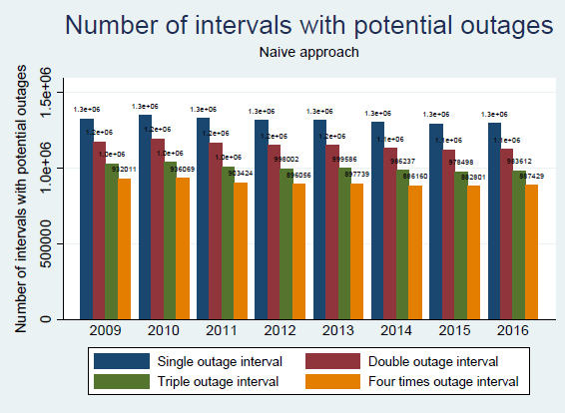
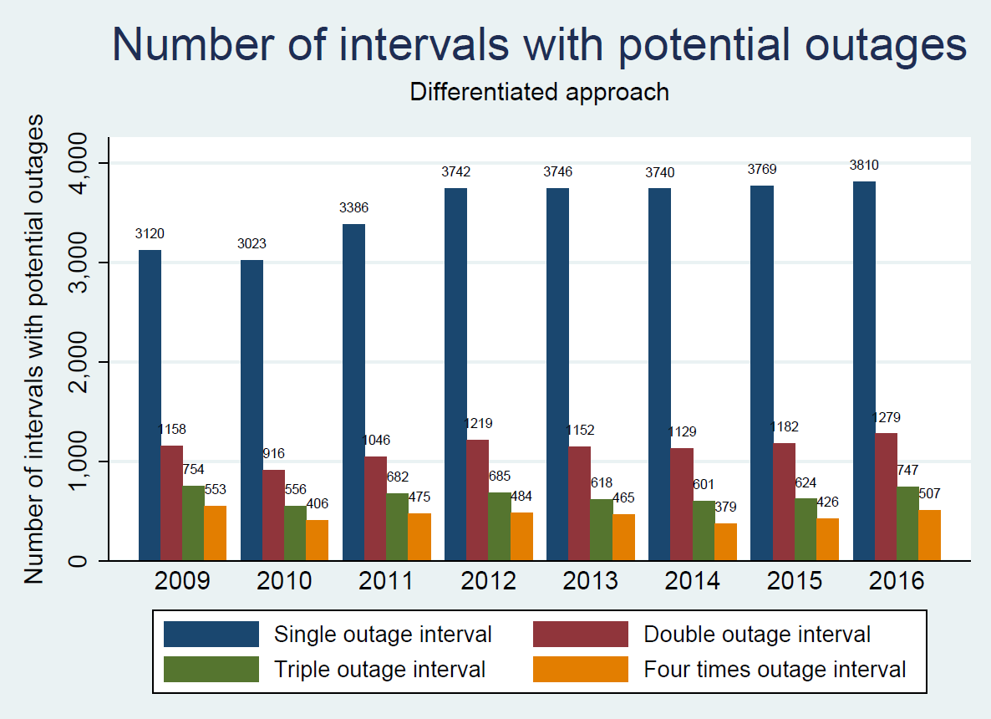
Results
Naive approach vs. differentiated approach

Slide 9
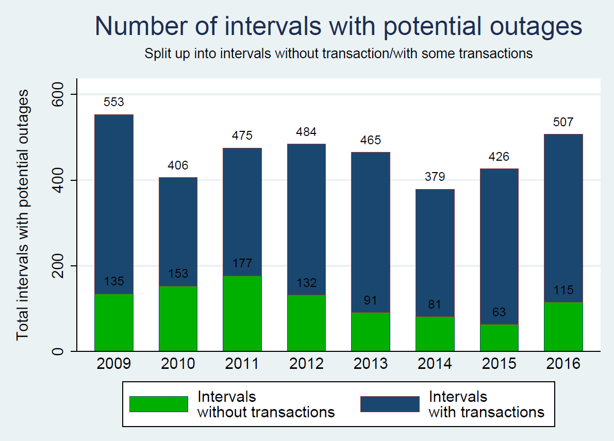
Results
Does an outage mean no transactions?

Slide 10
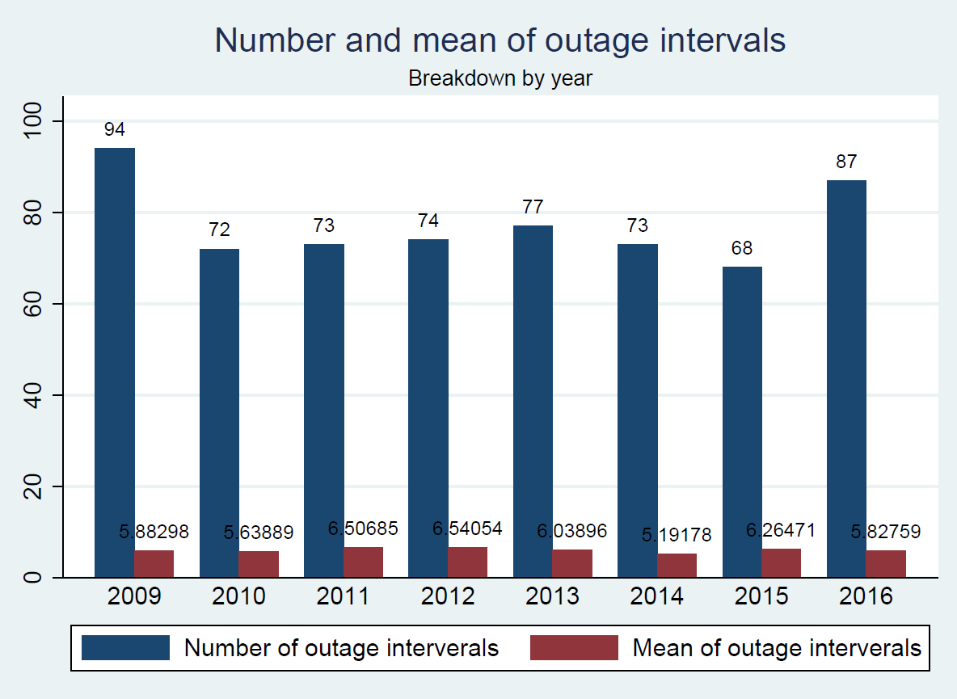
Results
Mean duration and total number of outages

Slide 11
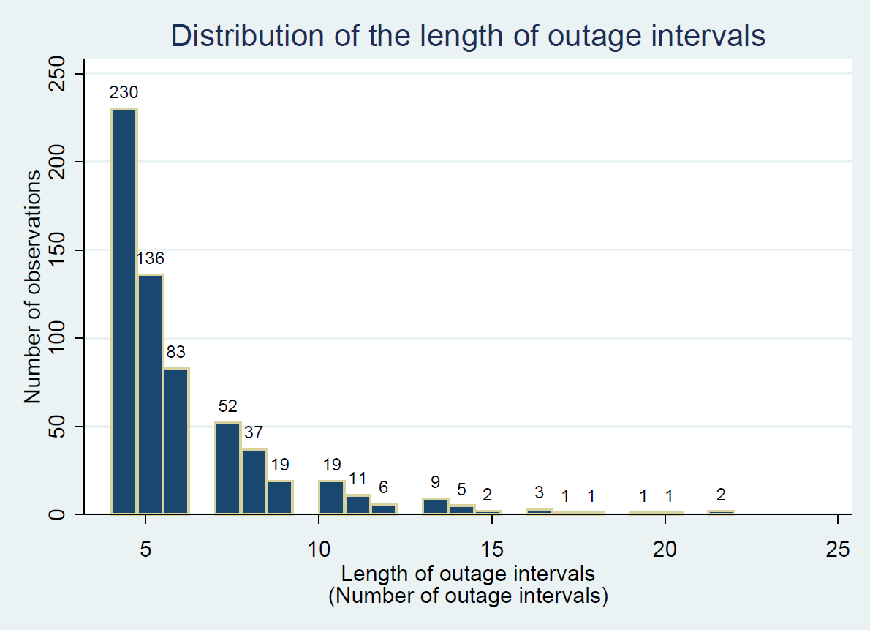
Results
Duration of outages

Slide 12
Conclusion
Advantages and challenges
Advantages
Useful for operators, overseers and researchers
First dataset on participants’ outages in TARGET2
Challenges
Tradeoff between coverage and reliability
Not well suited for smaller banks
Many observations lost due to conditions and adjustments
Relatively simple approach that includes business contingency

Slide 13
Conclusion
Way forward
Refinement of approach
Employment of machine learning techniques
Get more evidence
Study the effects of outages

Slide 14
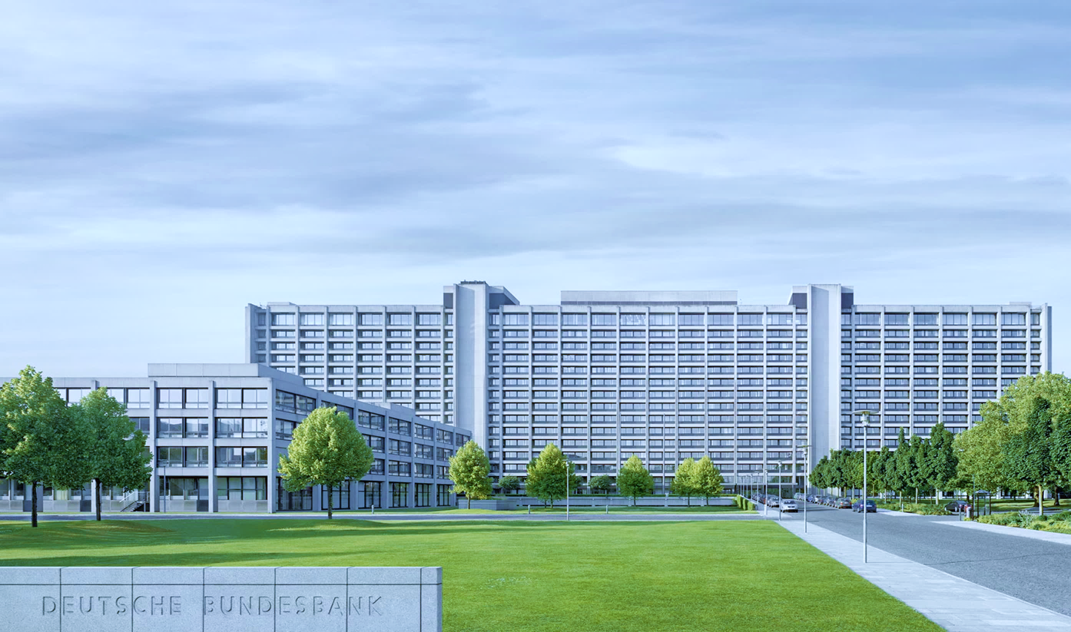
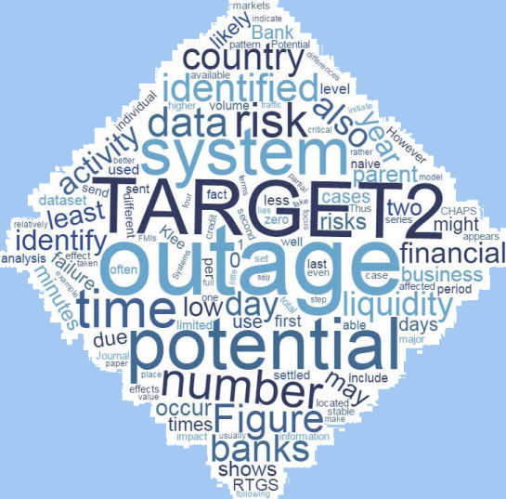
Thank you for your attention!
Marc Glowka
Deutsche Bundesbank
Payments and Settlement Systems
Marc.Glowka@bundesbank.de

