Slide 1
Monetary policy in the early months of 2015

Slide 2
Outlook in late 2014

Slide 3
Eurosystem projections in December 2014
GDP:
    2015: 1.0%
    2016: 1.5%
Inflation:
    2015: 0.7%
    2016: 1.3%

Slide 4
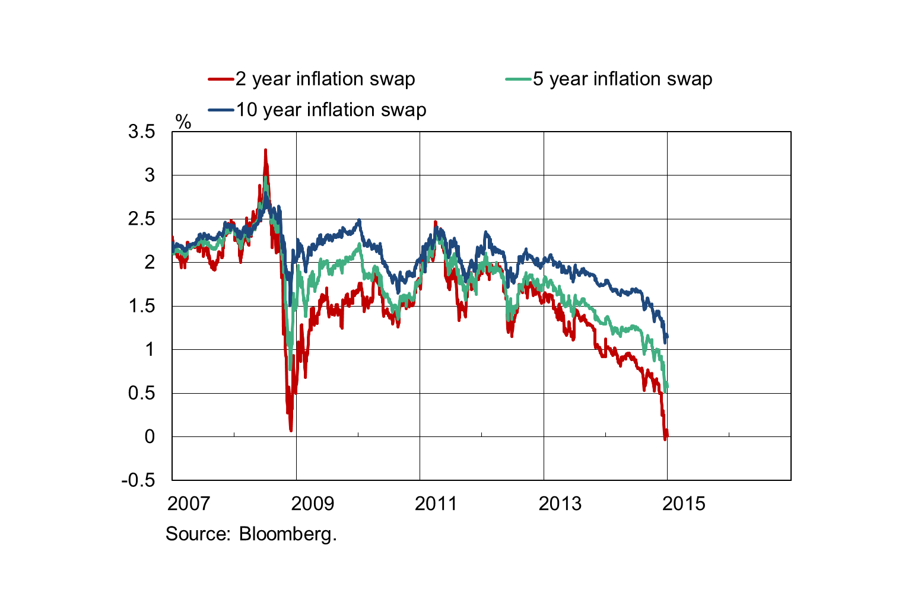
The markets’ inflation expectations fell sharply in late 2014

Slide 5
At the turn of the year, the markets expected inflation to be lower than the price stability objective for several years
Sources: Eurostat, Bloomberg and Bank of Finland calculations.

Slide 6
Deflation probability based on the distribution of inflation expectations had risen by mid-January

Slide 7
Monetary policy decisions in 2014 and 2015: new instruments, price stability objective unchanged interest rate policy, credit support, extensive securities purchases and guidance of expectations

Slide 8
Interest rate policy in 2014
Central bank interest rates reduced to the zero lower bound
  Interest rate on main refinancing operations 0.05% (September 2014)
  Interest rate on the deposit facility -0.20% (September 2014)
The full allotment policy safeguarding banks’ access to central bank refinancing will be continued at least until the end of 2016.

Slide 9
Measures to support provision of credit in 2015
Banks will be provided access to longer-term central bank refinancing (maturing in 2018) at a fixed rate of 0.05% for provision of credit to the real economy (excl. housing)
Third purchase programme for covered bonds issued by banks (CBPP3)
  Since October 2014, purchases conducted to the value of EUR 60 billion
Asset-backed securities purchase programme (ABSPP)
  Since November 2014, purchases conducted to the value of EUR 4 billion

Slide 10
Key contents of the new decisions in January 2015
Expanded asset purchase programme
    Bonds issued by euro area governments, government agencies and European institutions as a new target for purchases
    Combined monthly asset purchases under the three programmes of EUR 60 billion from March 2015 until at least September 2016 (totalling EUR 1,140 billion)
      The Bank of Finland will primarily buy Finnish government bonds (itself carrying the credit risk involved) and bonds issued by European institutions (for which the credit risk will be shared amongst Eurosystem central banks).
      Forward guidance
    Purchases will be continued, if necessary, even after September 2016 until the Governing Council of the ECB considers the inflation rate has returned to levels consistent with the price stability objective .

Slide 11
Channels of influence of a more accommodative monetary policy
Lowers real interest rates and eases financing conditions in the economy
  interest rates at the longer end decline, financing conditions for companies and households become easier, securities prices rise
  higher inflation expectations mean lower real interest rates
  corporate and household confidence improves
Increases demand and boosts inflation
  consumption and the profitability of investments increase
  external value of the euro depreciates

Slide 12
Early impact of monetary policy measures

Slide 13
ECB staff macroeconomic projections in March 2015
(change relative to December 2014 Eurosystem projections)
GDP:
    2015: 1.5% (+0.5)
    2016: 1.9% (+0.4)
    2017: 2.1%
Inflation:
    2015: 0.0% (-0.8)
    2016: 1.5% (+0.2)
    2017: 1.8%

Slide 14
Recovery in market-based inflation expectations after monetary policy measures

Slide 15
Monetary policy has reduced the probability of deflation

Slide 16
Sharp fall in long-term bond yields over the past year

Slide 17
Short-term government bond yields: broad-based decline into negative territory

Slide 18
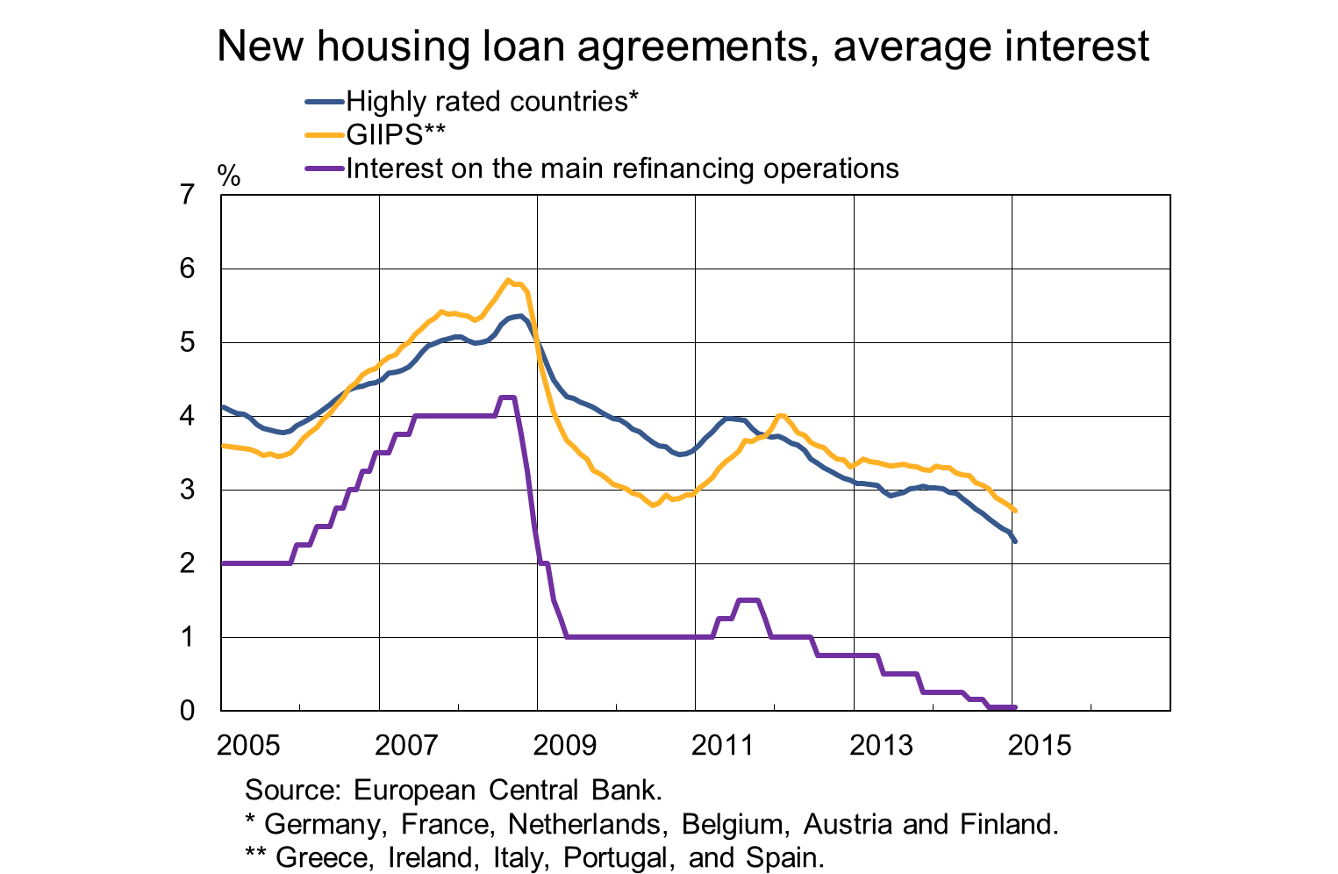
Monetary policy impacts: average interest rates on new housing loans

Slide 19
Monetary policy impacts: transmission improved, but still uneven

Slide 20
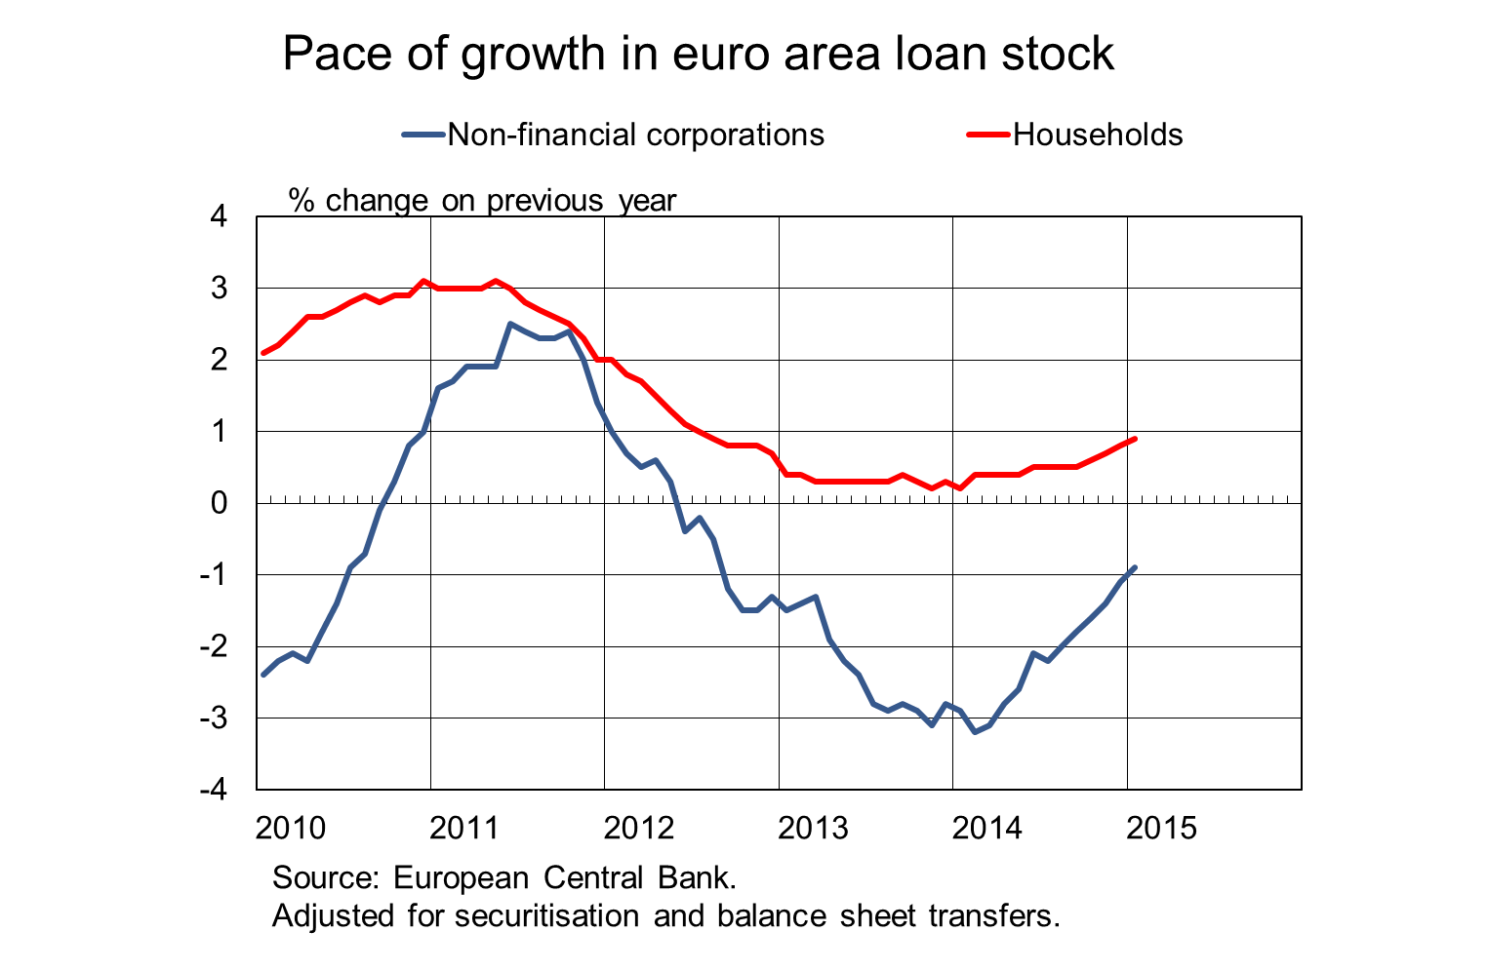
Loan stock improved

Slide 21
Euro fallen strongly against the dollar since the divergence in interest rate outlooks
Source: Bloomberg

Slide 22
Extremely accommodative monetary policy essential, but on its own insufficient

Slide 23
Accommodative monetary policy effective, if supported by measures in other areas of economic policy
Sustainable growth cannot be based on excessive debt in either the public or the private sector:
  there is a need for growth and structural reforms to strengthen the public finances as well as balance sheet adjustments in different sectors;
  the need is greater in countries with limited scope for increasing public sector demand, or where the working-age population is no longer growing;
  consistent adherence to the Stability and Growth Pact will sustain the credibility of the public finances.

Slide 24
Macroprudential policy is important in a time of exceptionally accommodative monetary policy
Negative side-effects of accommodative monetary policy cannot be entirely ruled out:
  a prolonged low level of interest rates and the additional relaxation brought by securities purchases could inflate the risks to financial stability;
  the euro area must maintain readiness to actively deploy macroprudential policy tools if required;
  an absolute requirement is the existence of effective macroprudential tools in each Member State.

Slide 25
Euro & talous contains two feature articles:
Tomi Kortela: Is the euro area at risk of Japanese-style deflation?
With its new monetary policy measures, the euro area has reduced the risk of Japanese-style deflation.
Jarmo Kontulainen and Tuomas Välimäki: The financial crisis changed the instruments but not the objectives of monetary policy
Commitment to an accommodative monetary policy stance is all the more important, the lower interest rates are and the further inflation expectations are below the price stability objective.

Slide 26
Bank of Finland’s result and profit distribution

Slide 27
Profit EUR 150 million
Low interest rates have had and will continue to have a weakening effect on the Bank’s result.
In 2014, the Bank’s profit amounted to EUR 150 million (2013: EUR 239 million), of which EUR 137.5 million (2013: EUR 180 million) has been made available for the needs of the State.
Central banks still have significant exposures and risks. The new monetary policy operations have expanded the balance sheet and increased the interest rate risk. The balance sheet has accordingly been strengthened through additional provisions.
The result is mainly composed of income from monetary policy items (EUR 191 million) and investment income (EUR 113 million). Operating income covers operating expenses (EUR 89 million), profit distribution to the State and provisions.

Slide 28
Result and profit distribution 2002−2014

Slide 29
Thank you!

