Slide 1
Financial stability
Euro & talous 2/2015

Slide 2
Revised format for financial stability assessment
Publication on new Bank of Finland Bulletin site
Comprises an editorial, a summary and a number of thematic articles
Topical articles and other material published on the site throughout the year
www.bofbulletin.fi/en/financial-stability

Slide 3
Lessons learnt from previous crises – unforeseen risks pose new threats
Broadly based strengthening of financial regulation and supervision
Macroprudential instruments created to prevent financial crises and enhance loss-absorbing capacity of financial institutions
However, new unpredictable risks may emerge in current exceptional operating environment

Slide 4
World economy and global financial markets in uncharted waters
Abundant liquidity in international financial system largely channelled into financial investments
Prolonged period of low interest rates encourages a search for yield and increased risk-taking
Strong increases and decreases in international asset prices also spill over to Finland

Slide 5
Finnish banking sector structurally vulnerable
Profitability and capital adequacy have remained strong in a difficult operating environment
The Finnish banking sector is
among the most concentrated in the euro area
dependent on funding raised from international financial markets
strongly linked across borders
focused on lending for house purchase
A concentrated banking system amplifies the severity of crises

Slide 6
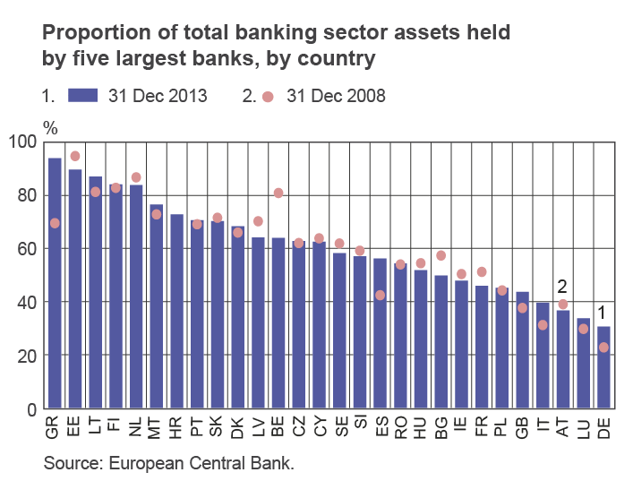
Finnish banking sector concentration among highest in euro area

Slide 7
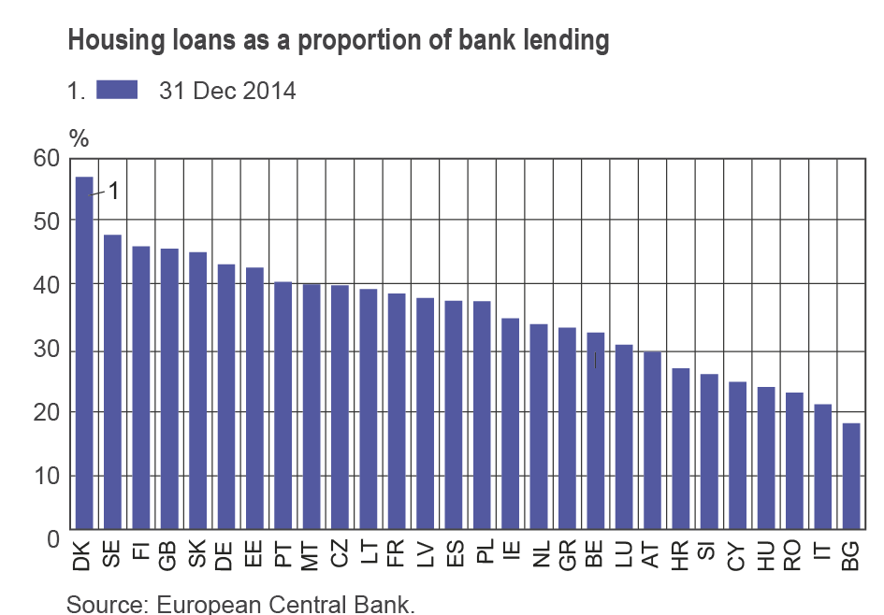
Lending for housing purchase a key activity for banks

Slide 8
Well-functioning corporate finance provides base for economic growth
Financing for SMEs mainly provided by banks, dependence further increased
Widening margins on corporate loans signalling reduced bank competition?
Diversified corporate finance beneficial to economic growth

Slide 9
Housing debt piles up – indebted households vulnerable to changes in economic conditions and interest rates
Amount of household loans relative to GDP doubled since turn of millennium
Housing debt burden and related risks concentrated on just a small group of debtors
Regional divergence in housing markets and debt in Finland

Slide 10
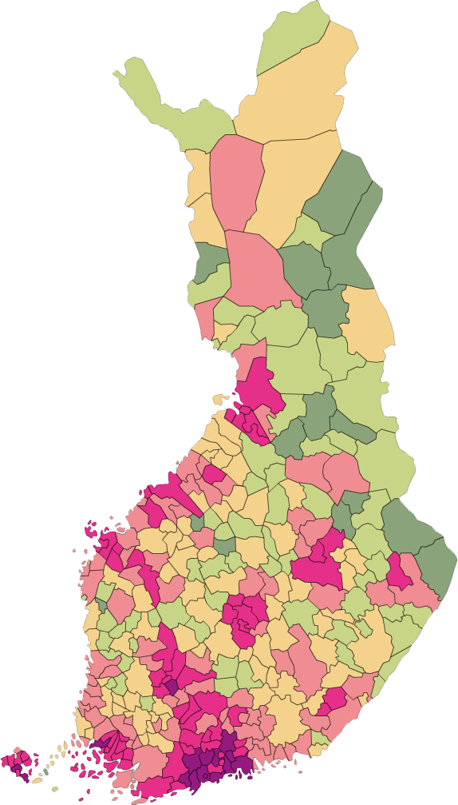
Housing debt concentrated in growth centres
Size of housing debt by municipality, per household with housing debt
Over EUR 112,700 (5% of municipalities)
EUR 89,100–112,700 (20% of municipalities)
EUR 71,200–89100 (25% of municipalities)
EUR 60,100–71,200 (25% of municipalities)
EUR 47,600–60,100 (20% of municipalities)
Below EUR 47,600 (5% of municipalities)
Housing loan debt categories are composed on the basis of the 5th percentile, lower quartile, median, upper quartile and 95th percentile of the distribution. The data refer to 2013.
Sources: Statistics Finland and Bank of Finland calculations.

Slide 11
As with debt, strong divergence in prices
Housing debt and house prices by municipality
210
EUR 1,000
180
150
120
90
60
30
600
1 400
2 200
3 000
3 800
EUR/square metre
The vertical axis indicates the average amount of housing loan per household with housing debt (EUR 1,000); the horizontal axis indicates the average selling price of an apartment in a housing company (EUR/square metre) in 2013. The diameter of a circle denotes the aggregate amount of housing debt in a municipality.
Sources: Statistics Finland and Bank of Finland calculations.

Slide 12
Low interest rates and slow economic growth weigh on insurance sector
Finnish insurance sector’s profitability and solvency are strong.
Slow economic growth and low interest rates cut insurance companies’ investment income and increase their liabilities.
More attention should be paid to potential systemic risks posed by possible extensive sales of insurance companies’ investments.

Slide 13
Increased risks to financial market infrastructure
Financial sector digitalisation improves the supply and availability of financial services, increasing the efficiency of operations and promoting competition.
The threat of a cyber attack against an increasingly digitalised financial sector has grown.
Internationalisation of the Finnish payment system and securities services has made Finland dependent on foreign service providers.

Slide 14
Conclusions

Slide 15
Tools must be available to curb debt accumulation and mortgage lending
The increase in debt levels makes households vulnerable.
A housing loan must not be too large relative to a household’s debt-servicing capacity.
Postponing debt repayment with interest-only periods is not a ‘free lunch’
Increases the household sector’s debt burden and vulnerability
Flexibility is justifiable, case-by-case
No reason to launch non-amortising housing loans in Finland, as experiences from other countries have been negative

Slide 16
Competition must be fostered in provision of financial services
Banks’ good cost-efficiency facilitates provision of competitive services.
We need diverse service providers and sources of finance.
The European Commission’s plan for Capital Markets Union will improve conditions for corporate finance and economic growth.
Growing popularity of non-bank finance means we must prepare for related risks.

Slide 17
Strong capital adequacy in Finnish financial sector must be ensured
MFIs must maintain their strong capital positions to ensure their loss-absorbing and lending capacity in all circumstances.
Authorities must have internationally harmonised tools to ensure this.
The regulatory differences between the Nordic countries are harmful.
The principle of proportionality must be observed: there must be discretion for applying regulations less stringently to smaller entities.

Slide 18
Thank you!

Slide 19
Authors of the financial stability assessment
Esala, Lauri
Fungáčová, Zuzana
Haajanen, Jyrki
Honkanen, Johanna
Koponen, Risto
Koskinen, Jenni
Koskinen, Kimmo
Manninen, Otso
Mäki-Fränti, Petri
Putkuri, Hanna
Pylkkönen, Pertti
Savolainen, Eero
Taipalus, Katja
Timonen Jouni
Topi Jukka
Tölö, Eero
Vauhkonen, Jukka

