Slide 1
AVALANCH Adversarial VALidation para Análisis de la Nueva Concesión Hipotecaria
Information Analysis and Suptech Division
Banco de España
The Impact of AI on Economy, Finance and Supervision
6 November 2025
DIRECTORATE GENERAL BANKING SUPERVISION

Slide 2
INDEX
Objectives
Techniques
Examples
Departamento de funciones horizontales

Slide 3

AVALANCH
Objectives
We want to know about ...
Shifts in mortgage origination behavior.
Reporting issues in new mortgage data sent to the Central Credit Register (CCR).
To find out we use the following resources:
New mortgage origination data from the Central Credit Register (CCR).
Adversarial Validation.
Decision trees due to their strong explanatory capabilities
Hypothesis testing to detect changes, and effect size to assess their relevance.
Horizontal Functions Department

Slide 4
Information Analysis and Suptech Division
Techniques
CCR information
Issuance of mortgage loans.
Granted to natural persons.
LOANS.
Main collateral: real estate mortgage.
Purpose: home purchase or refurbishment.
Our loan origination table includes information on:
Maturity.
Drawn and undrawn exposure.
Interest rate.
Collateral items and owners.
Debtor’s data: number, age, income, ...
Forbearance status, province, purpose, origin, ...
4
Horizontal Functions Department

Slide 5
Information Analysis and Suptech Division
Techniques
Adversarial validation
It is used when a model performs poorly despite correct implementation.
Hepls detect distribution differences between training and test datasets, checking whether the two sets are similar.
The training and test data are labelled.
An ML model is used to try to distinguish between them.
Adversarial validation is en efficient method to detect wheter CCR data differs across dates and to understand the nature of those differences.
Horizontal Functions Department

Slide 6
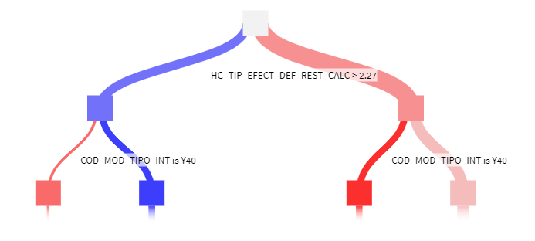
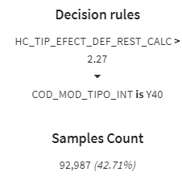
Information Analysis and Suptech Division
Techniques
Decision trees
Very simple and straightforward rules that grow recursively, searching for:
the best variables
the most effective cut-off points
It is visualized as a decision tree
Maximum explainability – We can identify which variables have changed.
Horizontal Functions Department

Slide 7
Information Analysis and Suptech Division
Techniques
Statistical hypothesis testing
Mean equivalence test for quantitative variables: Are the means of the variables the same across two different date ranges?
Fisher’s test for qualitative variables: Do the proportions of a variable differ depending on another variable, such as the origination date?
Effect size: If we find a difference, is it economically significant?
We apply the tests to a list of banks and variables to be analyzed, resulting in the execution of several hundred statistical comparisons.
We obtain a prioritized list of variables with significant changes.
Horizontal Functions Department

Slide 8
Information Analysis and Suptech Division
Valid for any kind of analysis
Comparisons by granting period
Temporal
Current month versus previous month, quarter or semester.
Identify changes in granting patterns.
Comparisons between entities
Entities
Entity vs System.
Different granting criteria between entities.
Comparisons between subpopulations
Portfolios
Differences by portfolios.
For example, which are the differences between mortgages granted through different channels?
HORIZONTAL FUNCTIONS DEPARTMENT

Slide 9
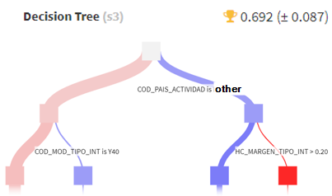
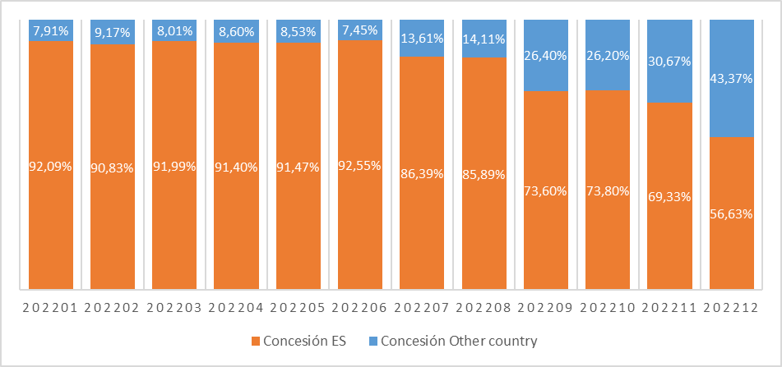
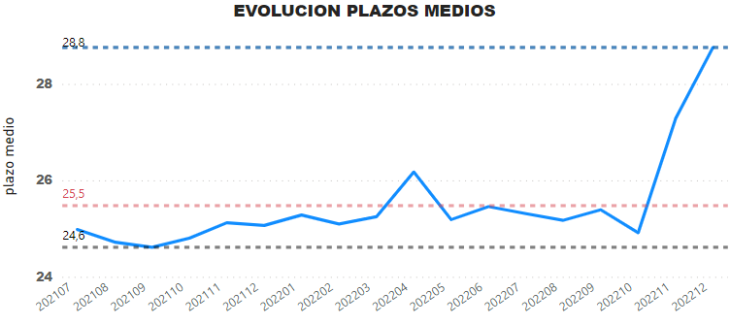

Information Analysis and Suptech Division
Examples - Evolution
Originations in other country
1
2
3
4
 |  | Other country |  | Spain
 | Value | 3 previous months | mar-23 | 3 previous months | mar-23
Fixed interest rate | Average debtors | 1.78 | 1.46 | 1.63 | 1.68
 | Interest rate | 4.78% | 5.28% | 4.69% | 3.80%
 | Number of instruments | 660 | 122 | 729 | 701
 | % of the period | 91.67% | 53.28% | 67.75% | 83.25%
 | Age average | 38.36 | 38.85 | 41.15 | 40.60
Variable interest rate | Average debtors | 1.78 | 1.46 | 1.55 | 1.52
 | Interest rate | 5.15% | 5.64% | 4.48% | 4.90%
 | Number of instruments | 60 | 107 | 347 | 141
 | % of the period | 8.33% | 46.72% | 32.25% | 16.75%
 | Age average | 40.64 | 38.51 | 43.97 | 44.09
AVERAGE TERM EVOLUTION
Average term
Horizontal Functions Department

Slide 10
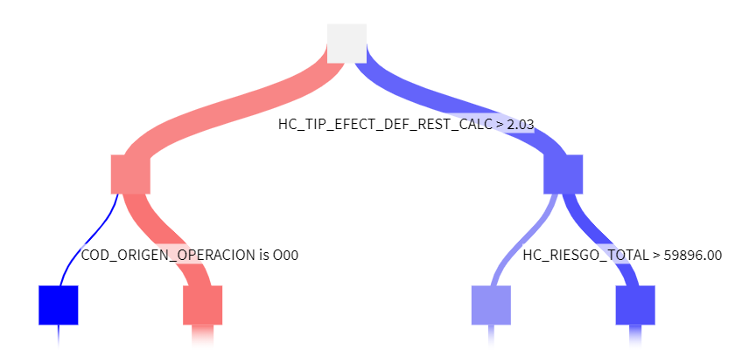
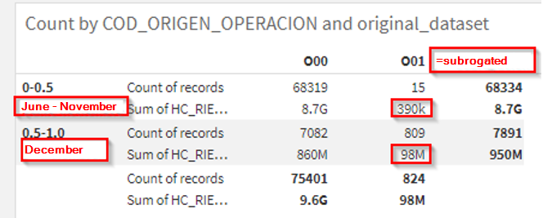
Information Analysis and Suptech Division
Examples - Evolution
Transaction origin variable
1
2
3
2627-FI101.E - Information on loans arranged or classified during the month (business in Spain)
Properties
Type of Balance : FinalBalance
Type of Amount : Thousands
Request Bank: 31
 | 202206 | 202207 | 202208 | 202209 | 202210 | 202211 | 202212
Of which: for house purchase (200) - Transactions (060) | 951 | 872 | 583 | 614 | 641 | 847 | 710
Of which: for house purchase (200) - Principal (j) (080) | 155,416 | 138,193 | 90,806 | 95,012 | 94,079 | 126,489 | 99,296
Horizontal Functions Department

Slide 11
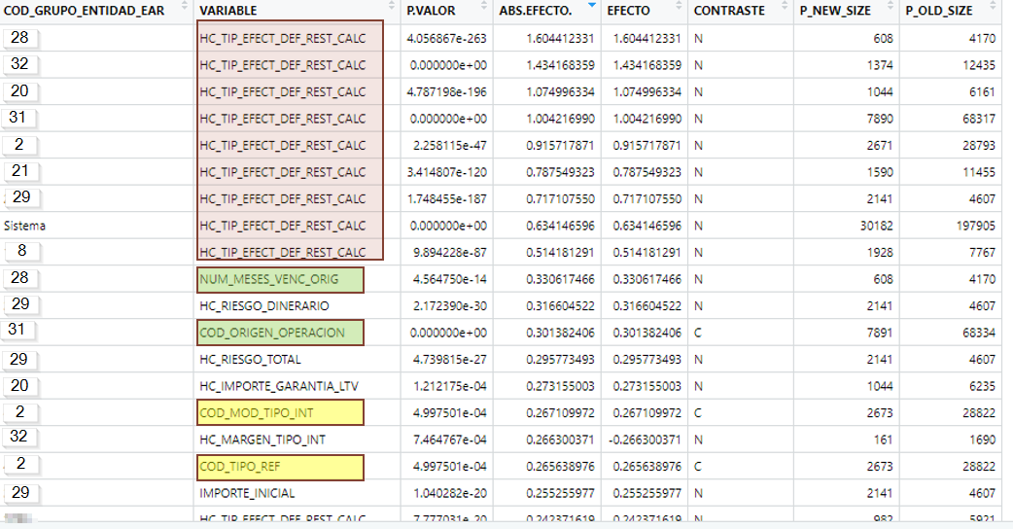
Information Analysis and Suptech Division
Examples
Battery of tests
Horizontal Functions Department

Slide 12
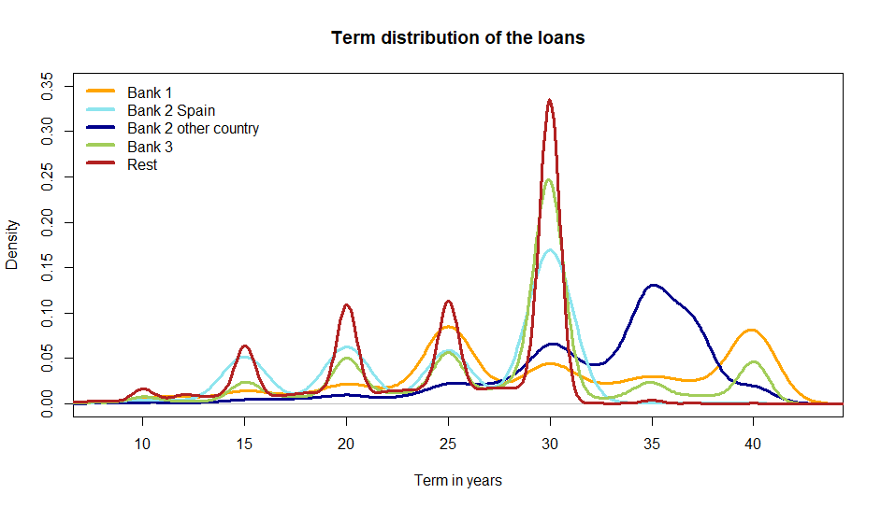

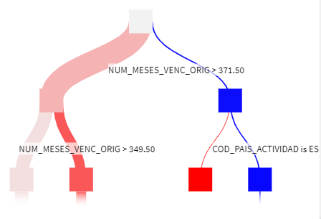
Information Analysis and Suptech Division
Examples – Entity vs System
Term of the new mortgages
1
Amount distribution for each entity | Up to 20 years | More than 20 and up to 25 years | More than 25 years and up to 30 years | More than 30 years and up to 40 years | More than 40 years
Bank 1 | 9,21% | 16,88% | 20,66% | 29,75% | 23,50%
Bank 2 | 15,34% | 13,49% | 31,39% | 38,10% | 1,67%
Bank 3 | 8,84% | 11,60% | 54,44% | 14,49% | 10,64%
Rest | 20,35% | 19,04% | 52,16% | 8,35% | 0,11%
Total | 19,59% | 18,75% | 50,19% | 10,08% | 1,38%
2
3
Bank 1
Horizontal Functions Department

Slide 13
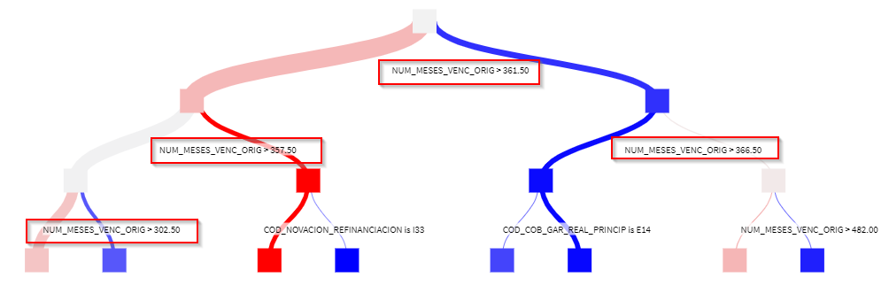
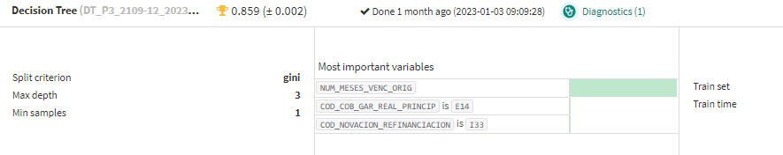
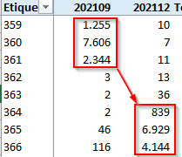
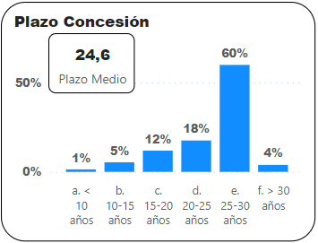
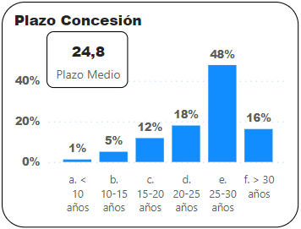
Information Analysis and Suptech Division
Examples - Evolution
Variable NUM_MESES_VENC_ORIG (Term in months)
1
2
3
3rd Quarter - 2021
4th Quarter - 2021
Term in years
Term in years
30*5+(30/4) ≈ 157 days ≈ 5 months
Horizontal Functions Department

Slide 14
Grupo de Análisis de la Información y Suptech
Conclusions
Results
The tool helps us identify meaningful changes between subpopulations.
We can detect temporal changes within an entity and differences across entities.
The tool has been useful in identifying reporting errors.
We have reported several changes in the granting patterns.
It has helped us gain insight into less common products, such as reverse mortgages.
Departamento de funciones horizontales

Slide 15
Grupo de Análisis de la Información y Suptech
Conclusions
Decision trees or tests?
Overall, most of the results are similar.
With the implemented statistical test, we are generally not unable to detect interactions between variables. For example, increasing interest rates in Spain and decreasing in other countries may be go undetected if the mean and variance remain stable.
In some cases, decision trees can be highly predictive but the differences they identify may not be very relevant. For example, an entity may grant fixed-interest loans at 2.5% with terms up to 15 years and 3% for longer terms. If rates are modifed to 3.52% and 4.02% the tree will reach an AUC close to 1 although the change is not very relevant.
Depending on the implementation, the treatment of null values may impact the results.
Departamento de funciones horizontales

Slide 16
Information Analysis and Suptech Division
Thanks for your attention.
Questions?
?
Horizontal Functions Department

