Slide 1

Using AI for customer benefit and efficiency in a retail bank
Heikki Henttu, Head of AI and Group Technology Strategy
November 2025

Slide 2


Heikki Henttu
Head of AI and Group Technology strategy

Slide 3
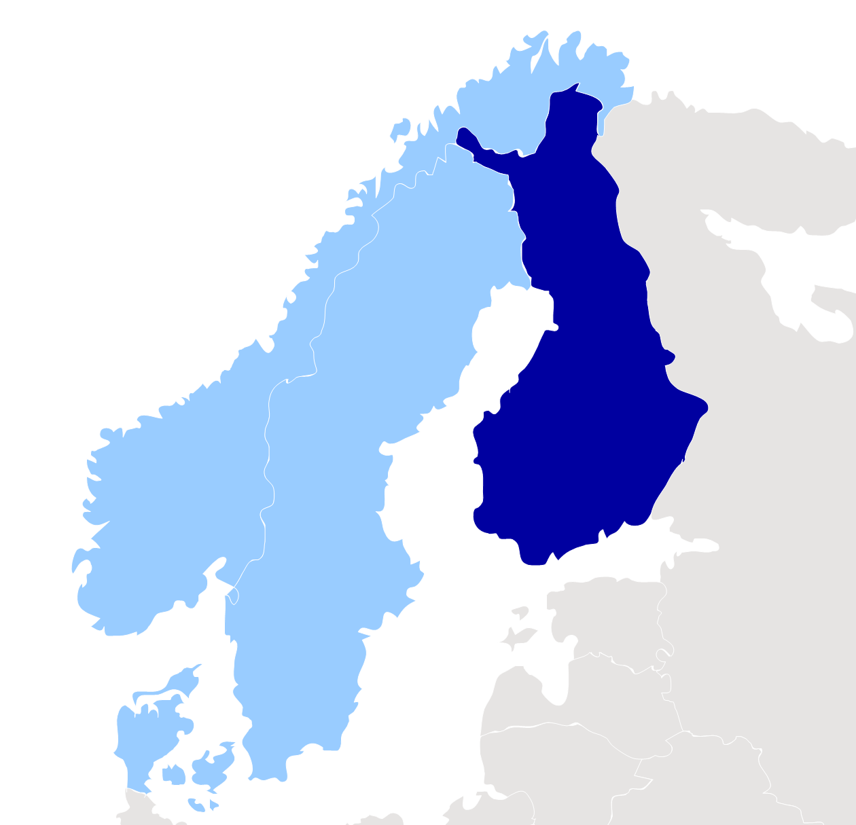
We have found our home in Finland
With a local
and Nordic perspective

Slide 4






Nordea in numbers
Nationalities:
+100
Languages spoken:
60
No. of employees in 2024:
30,000
Nordea offices (countries):
20
#1
Logins to our digital channels:
1.5 billion in 2024
Global Finance 2024 digital bank award winner for best user experience in Denmark, Finland and Sweden
Mobile bank: 4 out of 5 stars in app stores in the Nordics

Slide 5

Modern banking is all about Technology
Nordea is a place where we value true engineering skills

Slide 6

A trusted partner for all needs and life stages
6

Slide 7



Driving deeper digital connections
28%
active digital customers increase
37%
logins increase
to digital channels
99%
of customer interactions are digital
Jan ’22 vs Aug ‘25
Jan ’22 vs Aug ‘25
2025-H1

Slide 8



Making banking safe, easy and personal
>30%
76%
1.6 billion
reduction in
fraud losses
of all chats are handled by chatbot
personalised
in-app actionable insights
Total realised fraud losses
H1 ’24 vs H1 ‘25
Aug ‘25
~average yearly

Slide 9
Personalised experiences and smarter efficiencies powered by AI
Our AI agenda
Current use of AI
Long term
Next
Long term
Now
Next
Now
Next-gen autonomous banking experience
AI-driven process transformation
Customer assistant
6 million chats; ~75% handled by Nova Chatbot
Productivity tools
>18,000 users by end of 2025
Crime prevention
Automation in know your customer and transaction monitoring processes
Single & platform use cases for everyday
Value-creating use cases
AI technology platform to enable safe and scalable development
AI capabilities
Organisation & talent to drive innovation & value and leverage partnerships
Safe & trusted frameworks, policies and standards for AI

Slide 10




Lessons from our AI journey
x
It is all
about data…
…and change management
Customer
impact is clear…
…but value capture is vague
45%
concerned about data
bias and quality issues¹
70%+
issues stem from
people and processes,
not technology²
46%
AI has led to better customer satisfaction³
70-85%
of AI initiatives fail to deliver expected outcomes⁴
  ¹ IBM Global AI Adoption Index, ² BCG AI Adoption report, 2024, ³ AI in Finance, key statistics, trends 2025, ^{4.} MIT Sloan Management Review, Gartner and NTT Data, 2020

Slide 11

Life-long customer relationships:
AI as the enabler, not the driver

Slide 12
THANK YOU!

