Slide 1


Regulation of Artificial Intelligence
Prof. Dr. Dirk A. Zetzsche
Professor in Financial Law
Based on Zetzsche et al., AI and Risk Management (2025)

Slide 2
Overview
AI is everywhere
Risks of AI in Finance
Regulatory Approaches to AI & Finance
Integrated AI as Regulatory Problem
Conclusion & Recommendations

Slide 3
A. AI is everywhere
Public perception of AI
Delegation to AI Agent (1) => Outsourcing to entity that uses AI
Delegation to AI Agent (2) => Explicit AI Software
Delegation to AI Agent (3) => Implicit AI Functionality (“Integrated AI”)

Slide 4

Public Perception of AI

Slide 5
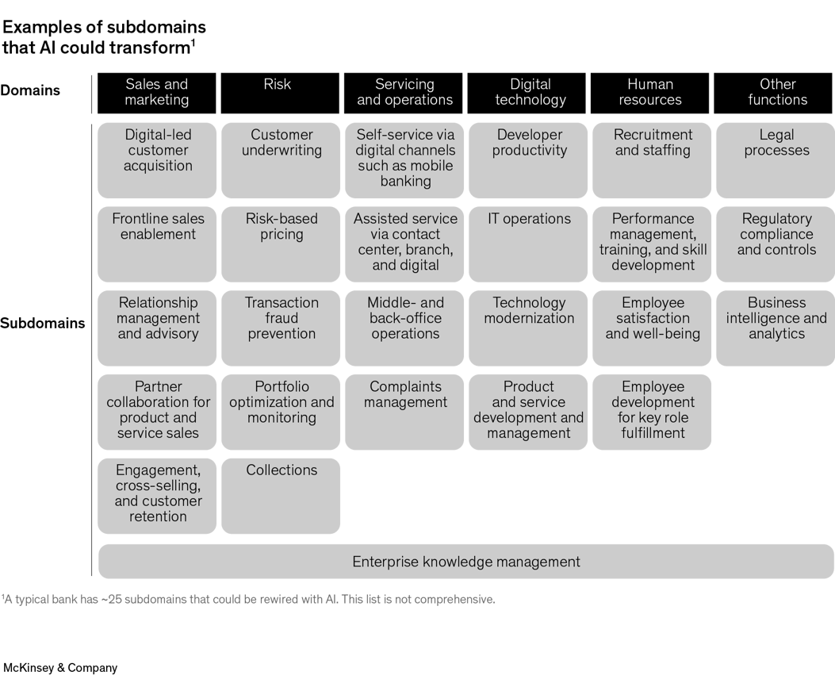

Slide 6


Delegation to AI Agent (1) => Outsourcing to entity that uses AI
Service Provider
Outsourcing Arrangement
Rating Agencies, Credit Scoring, Asset Manager, Data Provider, Product Distributor, KYC Provider

Slide 7
Delegation to AI Agent (2) => Explicit AI Software
Chat GPT, MS Copilot, Google Assistant, Siri, Alexa, AI Copilot (Joule), Oracle AI Data Platform (AIDP), Oracle Cloud Infrastructure (OCI), FCM AI Agent
Licensing

Slide 8
Delegation to AI Agent (3) => Integrated AI
SAP, Oracle, Temenos
Self-developed Management Cockpit
AI part of a major software service, but extent of AI use, interaction, datapools unknown / not specified.
All major software and OS vendors claim being “AI powered.”
Avaloq Insight
FI Serve

Slide 9
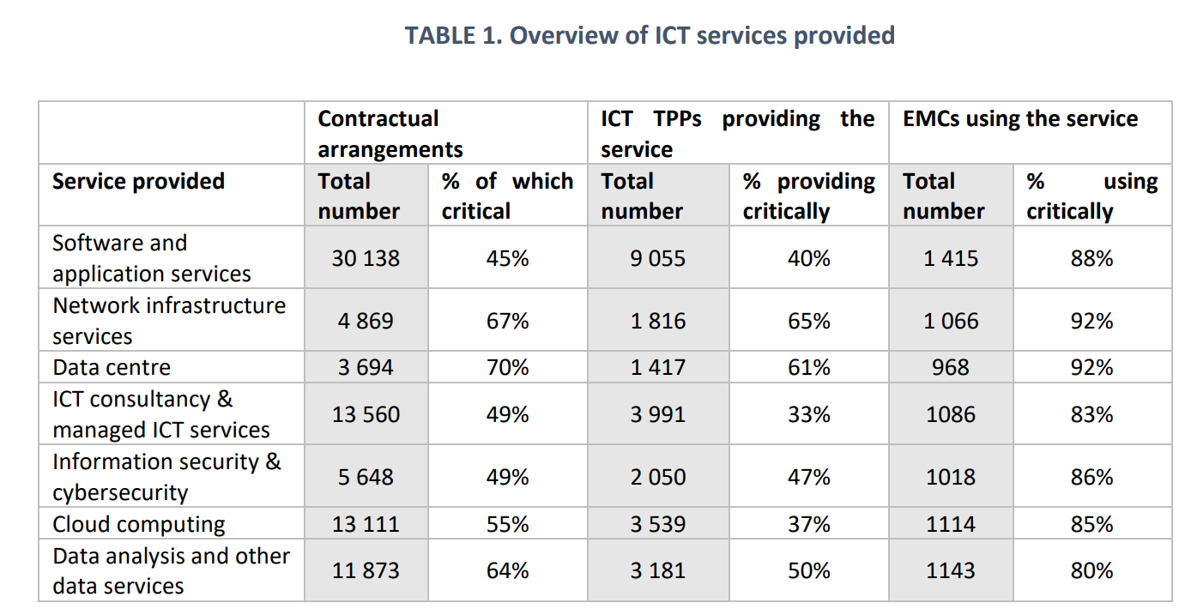
ICT services provided to 1,600 EU Financial Institutions (Joint ESAs)

Slide 10
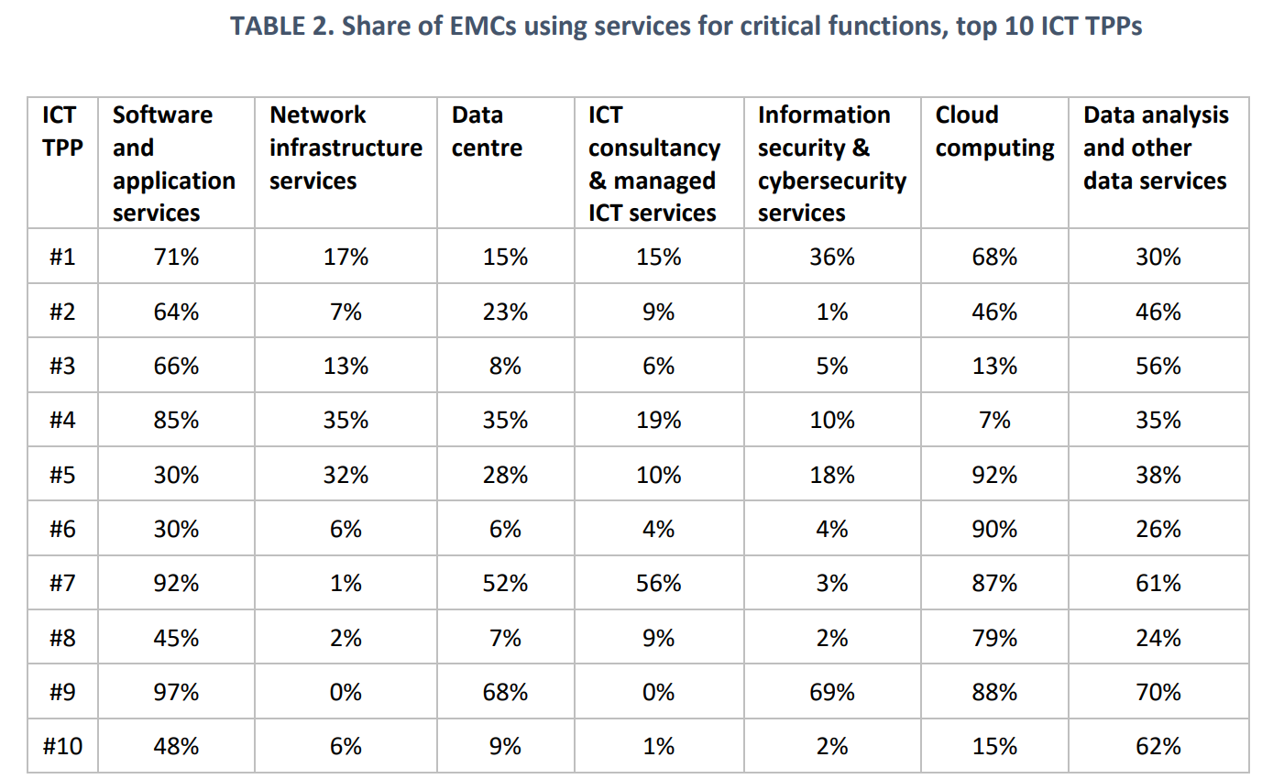
B. Risks of AI in Finance
Privacy as Trust
Client protection
Systemic Risk

Slide 11
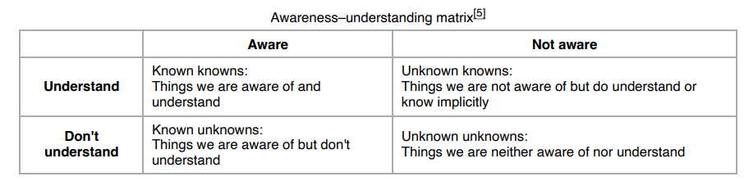
B. Risks of AI in Finance: Joseph Luft and Harrington Ingham, Johari Window
Secret collusion
Systematically wrong decisions
Capital misallocation
Large losses (“mistrades”, bad investments)
Compliance risks (fines, penalties etc)
Hidden interrelations etc

Slide 12
C. Regulatory Approaches to AI & Finance
AI Act => privacy focus
Humans in the Loop => limits of human capacities: KUK or UKUK
Capital requirements => SERB => limits of bank supervision
Delegation rules (general) => tail waggles with the dog
DORA approach?

Slide 13
Risk Manage-ment Duties of Financial Entities
ICT Risk Management
Governance and organisation (Article 5)
ICT risk management framework (Articles 6 to 16)
ICT systems, protocols, and tools
Identification, classification, and documentation of ICT risks
Prevention, detection, response, and recovery
Data back-up, restoration, and recovery
Capability building
Crisis communication
Vendor strategy
Implementation strategy for the whole framework
Simplified ICT risk management framework for certain small and non-interconnected financial entities
II
I
ICT Incident Management, Classification, and Reporting
Harmonised management, classification, and reporting regime for cyber incidents (Articles 17-20)
A system to disseminate information, enabling NCAs, the ESAs, the ECB, and the spe-cialist agency ENISA to manage cyber threats throughout the EU (Articles 19 and 22)
A possible next step may be to establish a single EU hub for major ICT-related incident reporting by financial entities (Article 21)
III
Digital Operati-onal Resilience Testing
Mandatory resilience testing, including advanced TLPTs for certain financial entities
IV
ICT Third-party Risk Manage-ment
Risk management principles, including key contractual provisions (Articles 28-30)
Oversight framework for critical third-party service providers (Articles 31-44)
V
Information and Intelligence Sharing
Formalisation of cyber threat information and intelligence sharing amongst financial entities
Requirement to notify participation in such arrangements with competent authorities
VI
VII
Competent Authorities
Competence of and collaboration among supervisory authorities

Slide 14
C. DORA Incident Management Framework
identify, respond to, and manage unexpected events or disruptions that can affect an organization’s operations, security, or integrity.
quickly restore normal operations and minimize the impact of the incident.
Detection and Identification: Early identification of incidents through monitoring and alert systems.
Response: Immediate actions taken to address and mitigate the incident, including containment measures.
Communication: Effective communication strategies to inform stakeholders and coordinate response efforts.
Resolution and Recovery: Steps to resolve the incident and restore affected systems and services.
Post-Incident Analysis: Investigating the incident to understand its causes and prevent future occurrences.

Slide 15
C. DORA Business Continuity Framework
plan and prepare to ensure that an organization can continue to operate and deliver critical services during and after a disruption. It focuses on maintaining essential functions and minimizing downtime.
Business Impact Analysis (BIA): Identifying critical business functions and the impact of disruptions on these functions.
Continuity Planning: Developing strategies and plans to maintain operations during various types of disruptions.
Resource Allocation: Ensuring that necessary resources, such as personnel, technology, and facilities, are available to support continuity efforts.
Training and Exercises: Regular training and simulation exercises to prepare staff for continuity procedures.
Plan Maintenance: Regularly updating and reviewing the continuity plan to reflect changes in the organization and external environment.

Slide 16
C. DORA Disaster Recovery
specific strategies and actions aimed at restoring IT systems, data, and infrastructure following a major disruption or disaster. It focuses on technical recovery to ensure that IT services and systems are brought back online as quickly as possible.
Data Backup: Regularly backing up data to ensure that it can be recovered in the event of a loss.
Recovery Solutions: Implementing technical solutions such as redundant systems, failover mechanisms, and cloud-based recovery options.
Recovery Procedures: Detailed procedures for restoring IT systems, applications, and data.
Testing and Validation: Regularly testing disaster recovery plans to ensure their effectiveness and reliability.
Coordination with Business Continuity: Ensuring that disaster recovery efforts support the overall business continuity plan.

Slide 17
C. DORA – AI as critical ICT TPP
AI as ICT service?
article 3 (21) of DORA, “ICT services” means “digital and data services provided through ICT systems to one or more internal or external users on an ongoing basis, including hardware as a service and hardware services which includes the provision of technical support via software or firmware updates by the hardware provider, excluding traditional analogue telephone services.”

Slide 18
C. DORA – AI as critical ICT TPP
AI as ICT service? - Outsourcing arrangements
Embedded in FS? Q&A: “if a regulated financial entity provides ICT services to other (regulated) financial entities in connection to their regulated financial services (or ancillary services), the related ICT services predominantly constitutes financial services.”
Rationale: financial entity subject to DORA RM rules
Rating agencies, AI-based traders etc.

Slide 19
C. DORA – critical ICTTPP?
Outsourcing / Delegation model – ICT TPP unless regulated financial services
Licensed software if provided on an ongoing basis (ongoing maintenance, support, or updates) => ICT service(+)
Integrated AI as own risk => DORA risk management

Slide 20
C. DORA – critical ICT TPP
number and size of reliant financial entities: whether an operational failure at the provider could jeopardise financial stability considering the number of financial entities which rely on the provider and their total value of assets;
systemic importance of reliant financial entities: the number of G-SIIs and O-SIIs which rely on the provider and their interdependence with other financial entities (including financial infrastructure services);
critical or important functions supported: the extent to which financial entities rely on the services in relation to their critical or important functions;
substitutability: the degree of substitutability of the provider considering potential alternatives and the necessary efforts of a potential migration.

Slide 21
C. Regulatory Approaches to AI & Finance: DORA – critical ICT SP
Oversight by Joint ESAs
Bespoke tech resilience framework
Regulatory approach effective?
RM challenge: how shall we prevent the known unknowns and the unknown unknowns?
Compensation & buffering: outsourcing and licensed services can come with liability pools (insurance, warranties) for unknown unknowns, but which size is adequate?
Integrated AI? – prevention (-) and buffering takes place by financial institution’s own capital.
Accumulation of the unknown unknowns.

Slide 22
D. Integrated AI as Regulatory Problem
AI Act => privacy focus
Capital requirements, insurance => SERB (difficult to price)
Product Liab. Dir. 2024/2853: physical harm, non-professional services
Operational resilience => Integrated AI: issue of FI rather than delegate;
How to address the unknown unknowns?
Does (EU) Regulation Matter? => liability allocation, sufficient capital, enforcement etc => will it buffer systemic risk?

Slide 23
E. Conclusion
In modern finance AI is everywhere, we just do not know where and how exactly
Many AI risks are known or unknown unknowns
Capitalisation and buffering challenging
Market concentration in ICT services as severe challenge: interlinkages? Ability to substitute monopolies (oligopolies)?
Organisational approaches (DORA) as second-best solution (without best solutions)
Incident Management, Resilience plans, BCA, Recovery
Kill Switch, Human Intervention etc
The Case for a Regulatory Coordination Mechanism re Systemic Risk, Operational Resilience, Consumer Protection, Antitrust, DP and other regulatory objectives

Slide 24

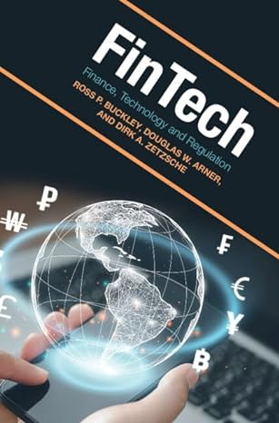

Prof. Dr. Dirk Zetzsche, LL.M.
ADA Chair in Financial Law / Inclusive FinanceFaculty of Law, Economics & Finance, University of Luxembourg Dirk.Zetzsche@uni.lu www.ssrn.com/author=357808
Thank you very much !

Slide 25














Prof. Dr. Dirk Zetzsche, LL.M.
ADA Chair in Financial Law / Inclusive FinanceFaculty of Law, Economics & Finance, University of Luxembourg, Dirk.Zetzsche@uni.lu www.ssrn.com/author=357808
Sandboxes vs Innovation Hubs
https://ssrn.com/abstract=3455872
FT4FI Roadmap
www.ssrn.com/abstract=3245287
Future of Data-Driven Finance
www.ssrn.com/abstract=3359399
Digital Finance Platforms
www.ssrn.com/abstract=3532975
Covid 19, Sustainability Crisis
https://ssrn.com/abstract=3783605
Corporate Technologies (AI etc.) www.ssrn.com/abstract=3392321
Rise of Tech Risk
www.ssrn.com/abstract=3478640
Distributed Ledgers / Blockchain
www.ssrn.com/abstract=3018214
TechFin / Data-driven Finance
www.ssrn.com/abstract=2959925
AI in Finance: Putting Humans ….
www.ssrn.com/abstract=3531711
Regulating Libra
www.ssrn.com/abstract =3414401
ICO Gold Rush www.ssrn.com/abstract=3072298
eID / KYC Utilities
www.ssrn.com/abstract=3224115
Regulatory Sandboxes
www.ssrn.com/abstract=3018534

