Slide 1
Middle East crisis driving up inflation and slowing growth
Bank of Finland Bulletin press briefing
12 June 2026

Slide 2
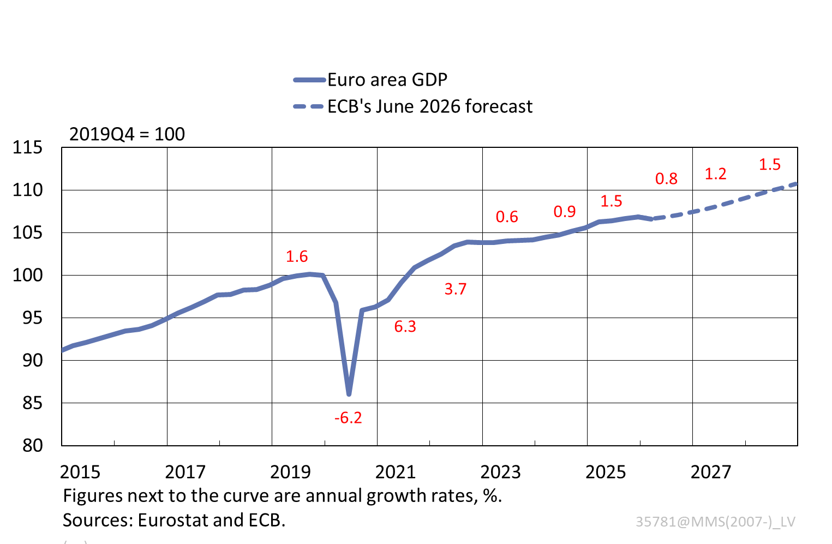
Middle East crisis slowing euro area growth
Growth underpinned by:
continuation of robust employment
increasing defence expenditure
Growth slowed by:
higher energy prices
geopolitical uncertainty
household cautiousness

Slide 3
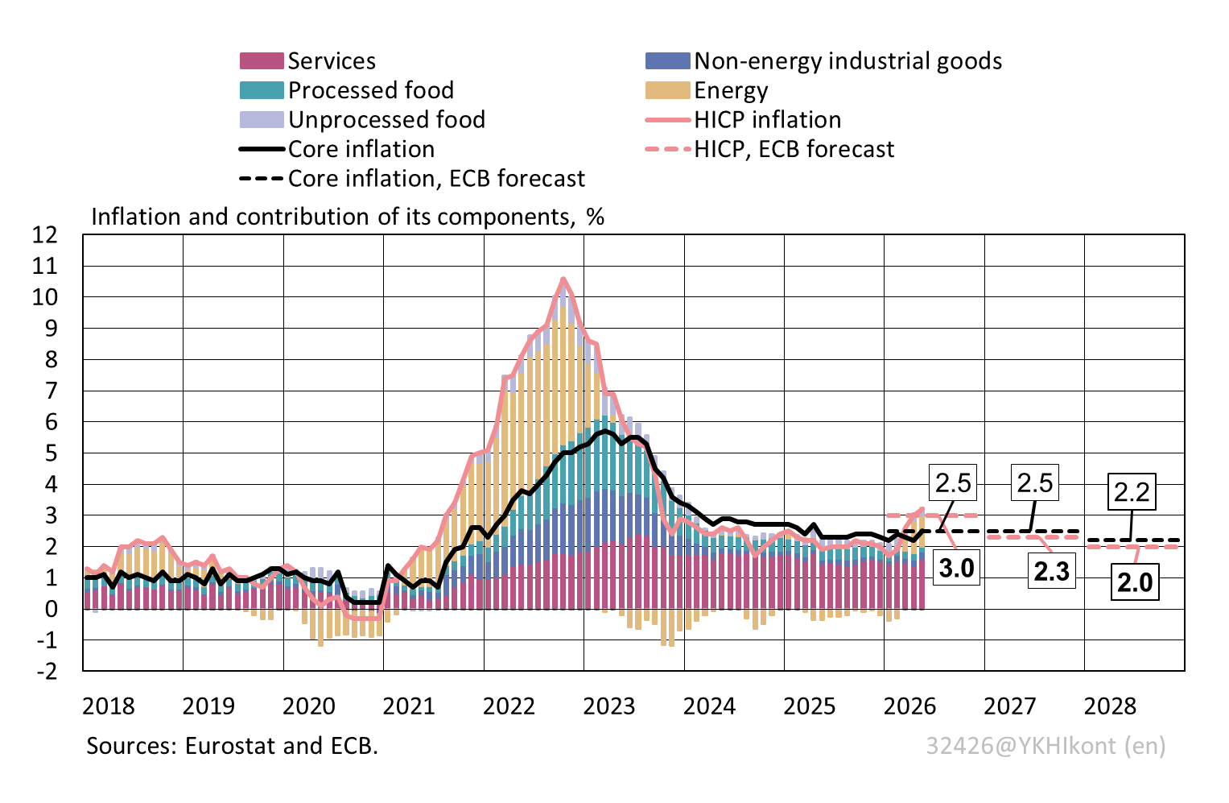
Euro area inflation has risen

Slide 4
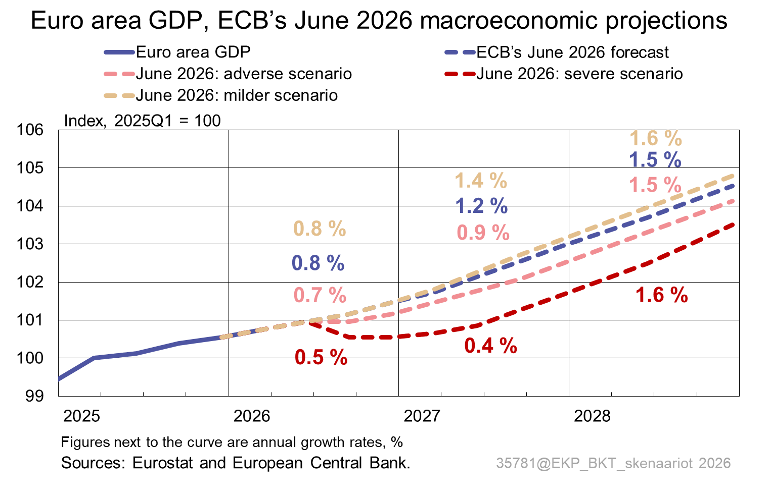
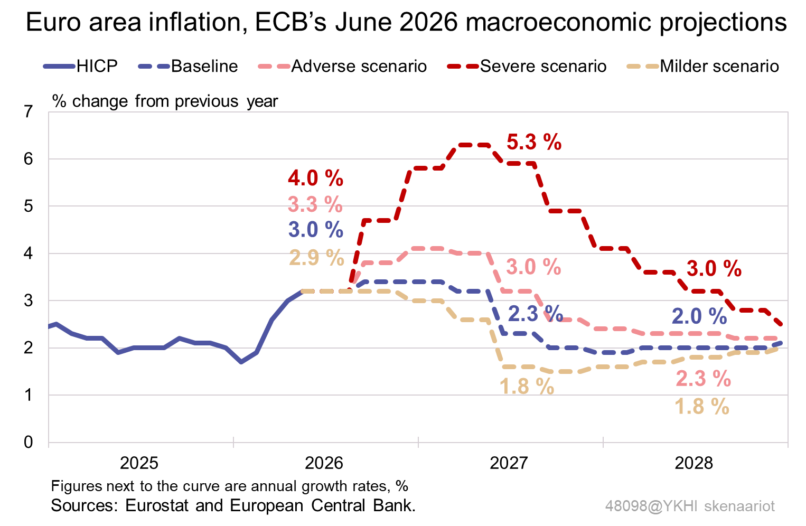
Scenario work supports assessment of war’s impact on outlook for growth and inflation

Slide 5
ECB’s Governing Council decided at its June meeting to raise its policy rates by 0.25 percentage points
The crisis in the Middle East is generating price pressures.
Inflation has already risen well above the ECB’s medium-term target, and risks to inflation are predominantly on the upside.
The interest rate increase is intended to keep inflation expectations anchored in the current uncertain environment and to help prevent the spillover of energy price pressures to other prices and to wages.
The ECB’s Governing Council is committed to stabilising inflation at around 2% in the medium term.
The Governing Council will take monetary policy decisions meeting by meeting, and on the basis of incoming data and analysis and an overall assessment.

Slide 6
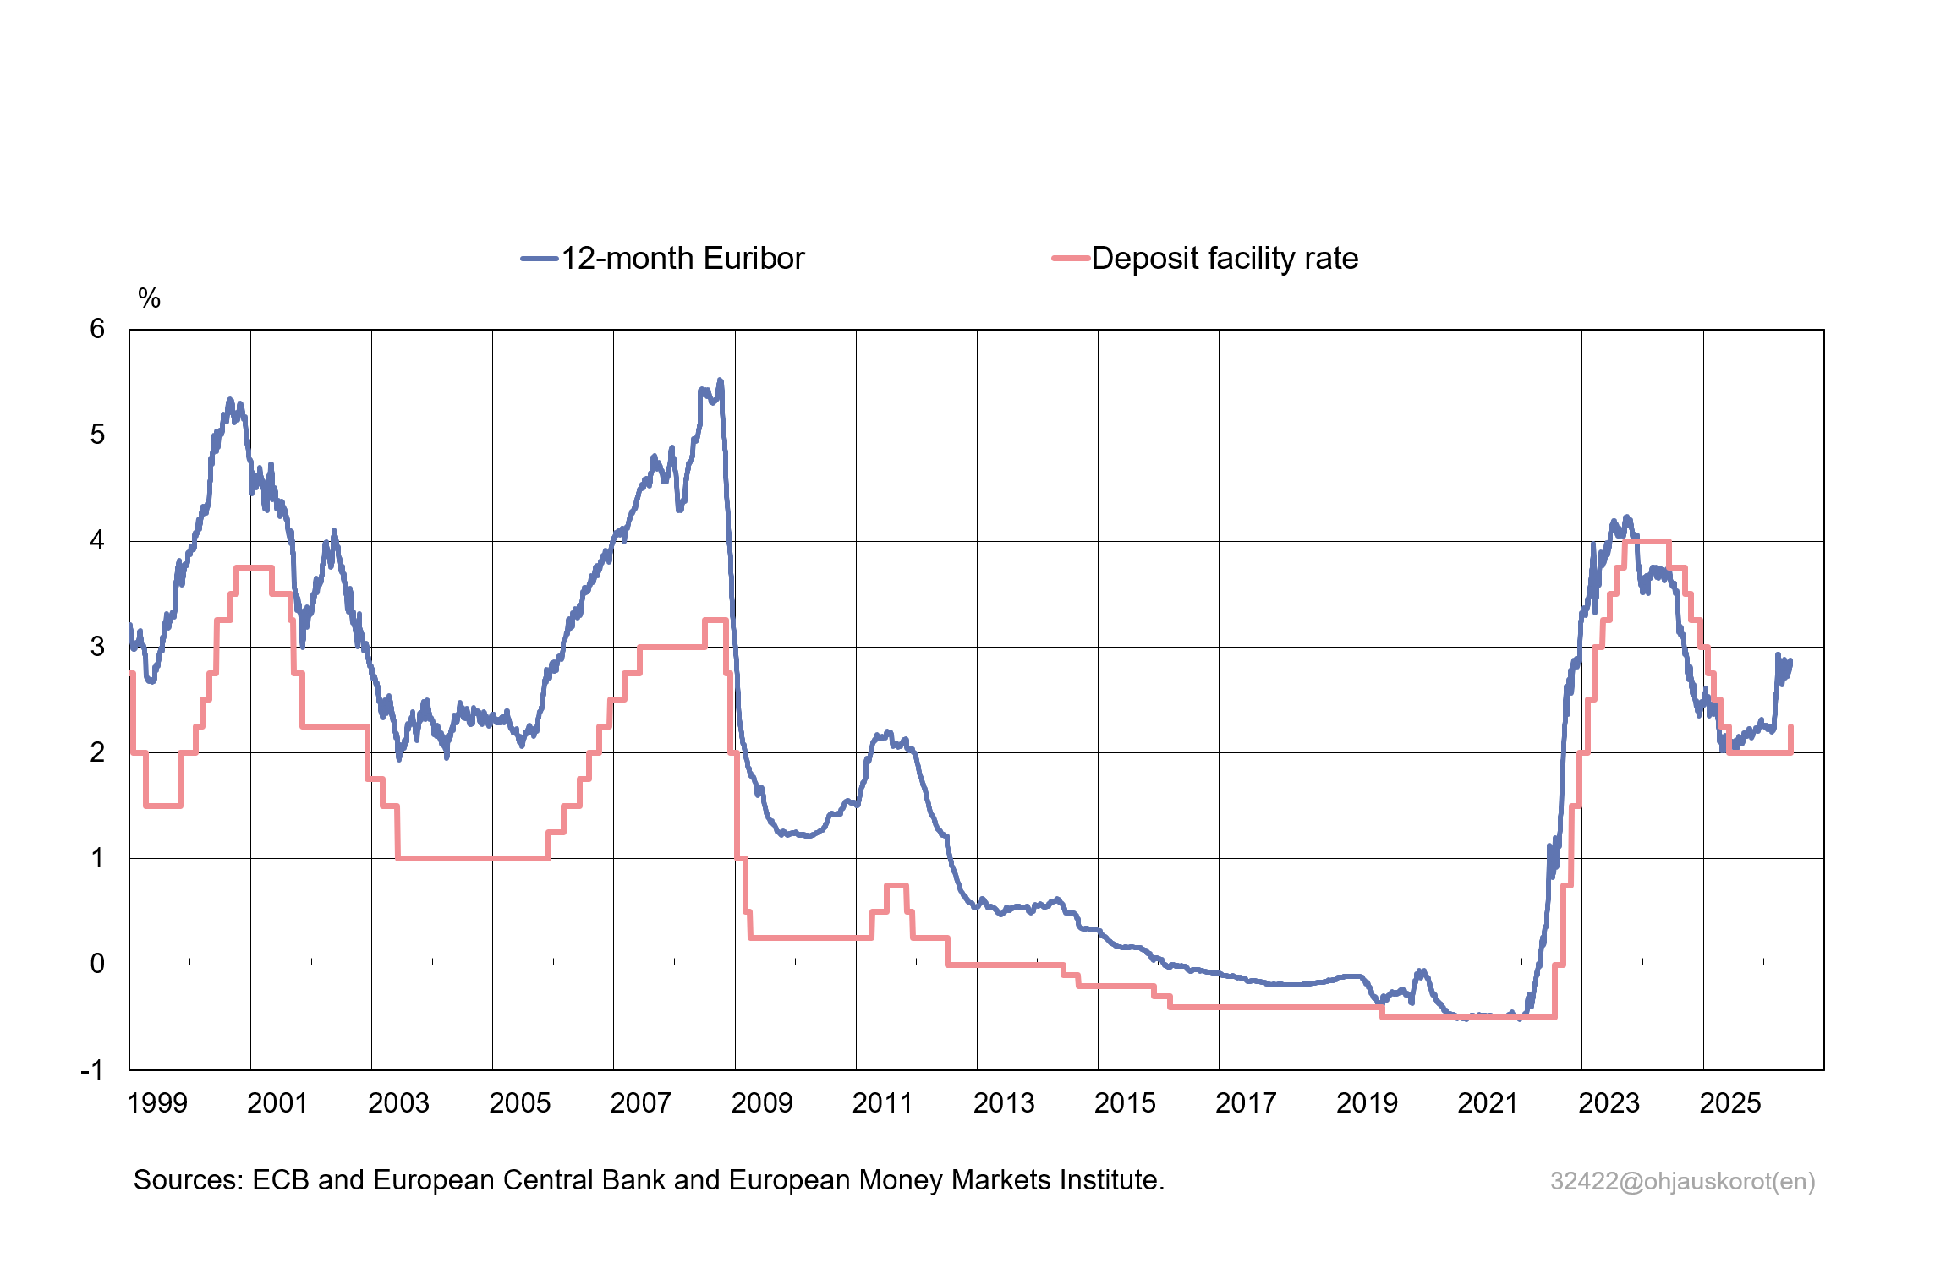
Market rates anticipate changes in key ECB interest rates
The 12-month Euribor (the most common mortgage reference rate in Finland) is now 2.846% (11 June 2026).
Market rates had already largely priced in the rate rise.
Market rates rose already in March-April, reflecting expectations on inflation and the ECB’s policy rate.
* The deposit facility rate will be 2.25% as of 17 June 2026.

Slide 7
Challenges for Finland’s public finances continue
Finland’s public finances are deeply in deficit and the general government debt ratio will continue to grow.
Together with higher borrowing costs, increased defence spending will cause significant additional pressure on the public finances.
The Council of the European Union opened an excessive deficit procedure (EDP) for Finland in January.
Finland was given until 2028 to put an end to its excessive deficit.
  More time is probably needed for this.
GDP growth is forecast to strengthen in 2027.
  Adjusting the fiscal policy stance from expansionary to neutral in 2027 would accord with the EDP requirements.

Slide 8
Main messages
The growth outlook for the euro area economy has weakened and the Middle East crisis is driving up inflation.
The interest rate increase in June is intended to keep inflation expectations anchored and to help prevent the spillover of energy price pressures to other prices and to wages.
The ECB’s Governing Council is firmly committed to stabilising inflation at around 2% in the medium term.
Finland’s GDP growth became more broadly based in the early months of the year, but the Middle East crisis is increasing uncertainty and slowing growth.
Reversing the trajectory of Finland’s public debt will require considerable fiscal consolidation in the years ahead.

Slide 9

Vakauden puolesta, tutkitun tiedon pohjalta.
Securing stability, in science we trust.

