Slide 1
BoF-PSS2 Today

Slide 2
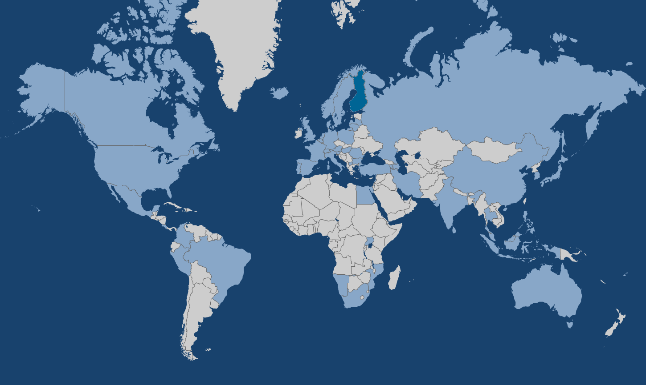
BoF-PSS2 Distribution
ARMENIA
AUSTRIA
UNITED KINGDOM
AZERBAIJAN
BELGIUM
BULGARIA
BRAZIL
CANADA
SWITZERLAND
CHINA
COLOMBIA
GERMANY
DENMARK
SPAIN
FINLAND
FIJI
FRANCE
HONG KONG
HUNGARY
INDONESIA
ISRAEL
INDIA
IRAN
ICELAND
ITALY
JAPAN
KOREA , REPUBLIC OF
REPUBLIC OF LEBANON
SRI LANKA
LITHUANIA
LATVIA
MACEDONIA
MEXICO
MALAYSIA
MOZAMBIQUE
MONGOLIA
NAMIBIA
NETHERLANDS
NORWAY
PERU
POLAND
PORTUGAL
ROMANIA
SERBIA
RUSSIAN
FEDERATION
SWEDEN
SINGAPORE
SLOVENIA
THAILAND
TURKEY
UGANDA
UNITED STATES
SOUTH AFRICA
EGYPT
COSTA RICA
PHILIPPINES

Slide 3

BoF-PSS2 Simulator
BoF-PSS2 simulator has a history of more than 15 years
101 granted licenses in 2017
  56% in central banks, 23% in academic institutions,
  the rest in ACH’s, CSD’s, ECB, BIS…

Slide 4
Key Drivers
CPSS-IOSCO (2012) Principles for financial
market infrastructures
BCBS (2008). Principles for Sound Liquidity Risk Management and Supervision (BIS)
BCBS (2010). International framework for liquidity risk measurement, standards and monitoring (BIS)
BCBS (2013). Monitoring tools for intraday liquidity management (BIS)

Slide 5
Latest Version 8.0.0 2017
Automated stress testing tool
New CCP (Central Counterparty) - simulation feature
Support for new MARIADB and MySQL versions
Enhanced support for DVP and PVP settlement processes with more than two linked transaction legs
Database rationalisation (-60% for results)

Slide 6
Automated Stress Testing Tool
Automatic generation and running of scenarios
Enhanced reporting
Automatic calculation of upper bounds, average sending times,…
Significant savings in consumed storage space
  Scenarios’ input data is not anymore duplicated
Possibility to modify the SQL-sentences used to filter the scenario data giving a lot of flexibility
Notes:
Training exercises that took 2 days can be performed in 1 hour.

Slide 7
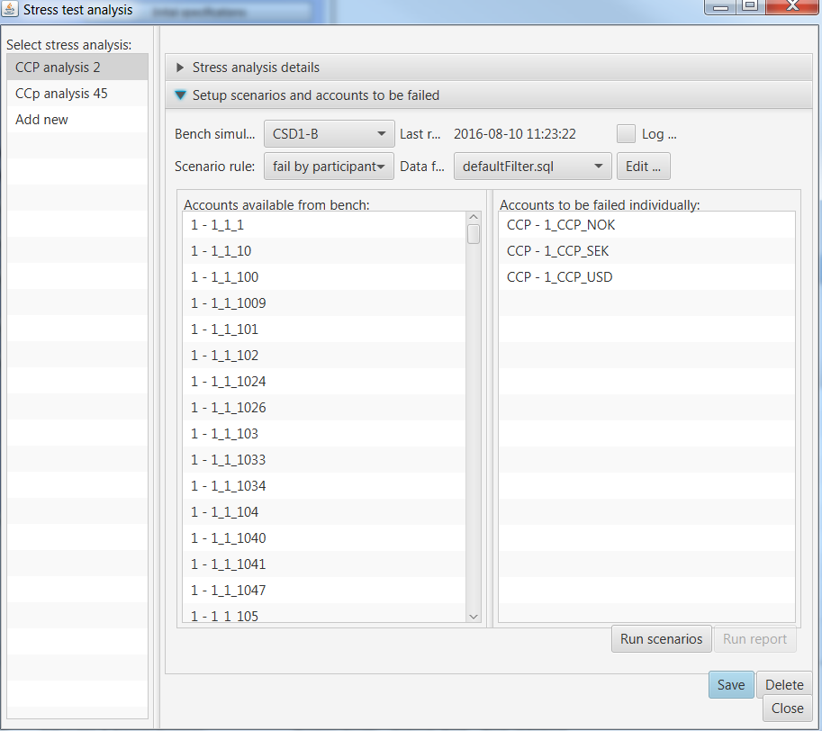
Automated Stress Testing Tool

Slide 8
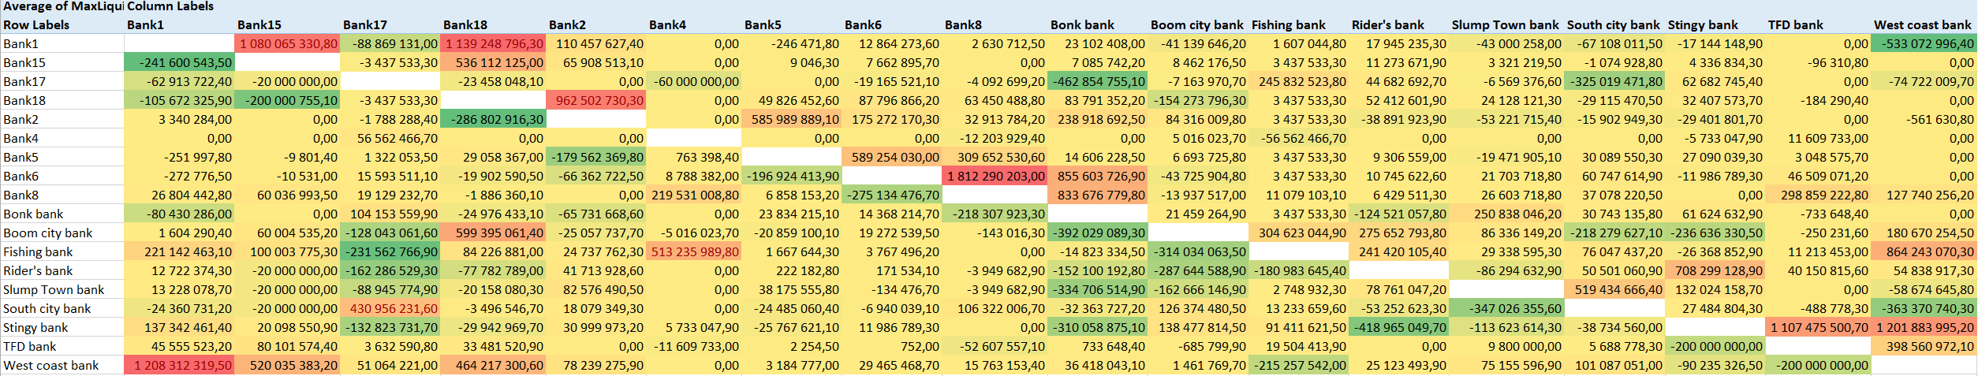
Counterparty Exposure Matrix

Slide 9
New CCP Features
Task automation tool for executing different steps consecutively and automatically
The tool performs novation and netting of trades
If needed, the tool generates the participant data and inital daily balances based on upper and lower bounds of liquidity calculated from the trade data.
The tool can split the trade data according to the CSD’s where the equities are ment to be settled
Simulations are set up automatically according to the trade data

Slide 10
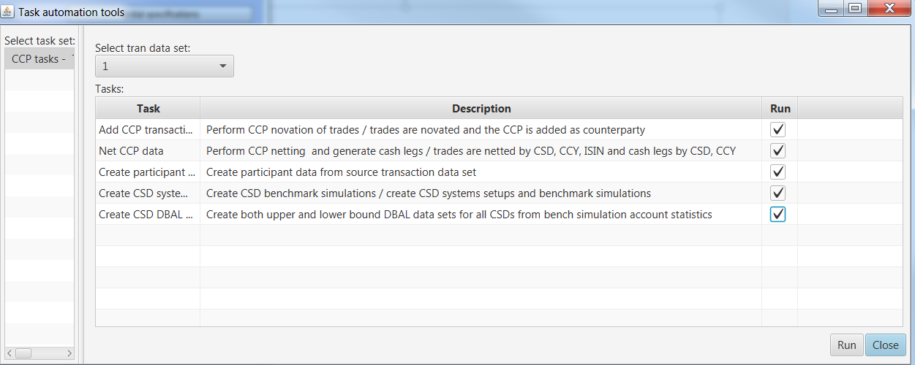
New Task Automation Tools

Slide 11
Developement 2018
Parallelisation of simulation processing
possibly
ABM
Liquidity squeezing scenarios
Static indicators

Slide 12
Availability
Version 8.0.0 is released and available for all the interested institutions as free of charge
Versio 9.0.0 with automated data importing tools will be released later in 2017
For further information contact
BOF-PSS@bof.fi
or visit
www.suomenpankki.fi/simulator

Slide 13
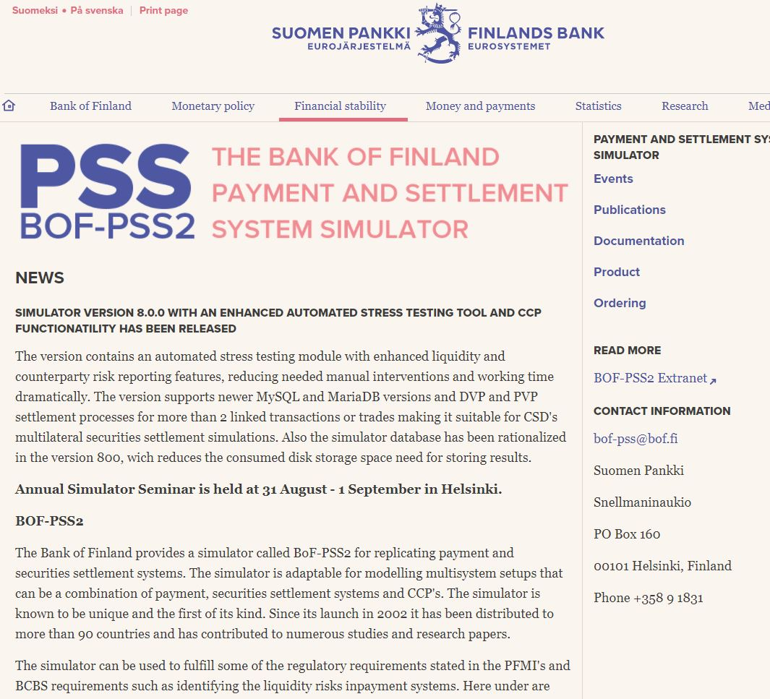

Slide 14
Services for BoF-PSS2 users
Training courses
  General Training course
  TARGET2 Simulator course
  Tailored on site trainings
User Support
  Help desk service
  On site consultations and advisory services
Feature Development
  Project estimation
  Change implementation

Slide 15

Overall agenda of the 15th simulator seminar
Day 1 | Day 2
Keynote presentation
Presentations 2 – 5 | Presentations 9 - 12
Lunch | Lunch
Presentations 6 – 8 | Presentations 13 - 14
Evening at BoF Villa | Farewell coctails
Payment system features, liquidity studies, machine learning, new indicators, big data analytics, critical participants, DLT, cryptocurrencies.
13 interesting presentations
Everyone is invited to the
dinner this evening at the
Bank of Finland’s Villa

Slide 16
Seminar participants
Areas of interest match
the seminar themes
Diversified global
participation:
  27 nationalities
  5 continents
  55 from CB’s, 6 from private side and 2 with research affiliation.
Users of the BoF-PSS2 simulator
  40% are already familiar
Topic | Number of votes (max 64)
Indicators based on Payment system data | 50
Contagion, cross-system analysis, networks | 43
Stress testing | 40
Liquidity saving mechanism | 33
System design | 25
Agent Based modelling | 17
Welcome!

