Slide 1
U.S. monetary policy and credit risk of new corporate credit lines
Lucy Qian Liu (IMF)
Viktors Stebunovs (FRB)
2023 RiskLab/BoF/ESRB Conference on Systemic Risk Analytics
June 8, 2023
The paper’s views are the responsibility of the authors and should not be interpreted as reflecting the views of the Board of Governors of the FRS, the FRS, or the IMF, its Executive Board, or its management.

Slide 2
Introduction
In the U.S., originations of syndicated corporate credit lines far exceed those of syndicated corporate term loans.
With the GFC and the pandemic, attention to lines because of massive drawdowns.
Not much known about a risk-taking channel of monetary policy that operates through originations of lines.
For good reasons?
Lines differ from loans, so methods and findings for term loans may not apply.
Borrowers are more likely to draw on a line when they are in difficulty, the regularity that banks must appreciate.

Slide 3
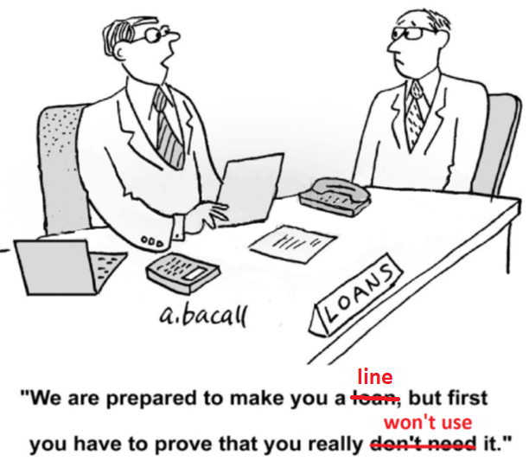
First rule of originating a risky credit line

Slide 4
Literature: Transmission meets loan contracting
Literature strands: Syndication, loan contracting, and monetary policy transmission.
Banks originate and retain corporate lines of credit.
Management of liquidity and capital risks by banks, in part through risk pricing.
Berg, Saunders, and Steffen (2016): Complex pricing of credit lines:
To compensate banks for options that contracts give borrowers, or/and
To screen borrowers for the likelihood of exercising the options.
This paper: Originations of risky lines in response to policy rates, conditional on pricing of lines and bank characteristics.

Slide 5
Data
Eventful period, with multiple monetary policy cycles, from 1995 to 2019.
DealScan for U.S. dollar lines originated by U.S. and foreign banks to U.S. borrowers.
Multiple syndicates to the same borrower around the same time.
Moody’s Expected Default Frequencies (EDFs) for borrowers’ ex ante credit risk.
Matched horizon of EDFs with maturities of lines.
Lines made to the same borrower may have different EDFs.
Wu and Xia (2016)’s shadow federal funds rate to proxy a U.S. policy rate (R).
Bank characteristics from Capital IQ and Barth, Caprio, and Levine’s global surveys of bank regulation and supervision.

Slide 6
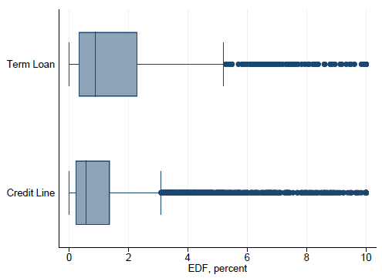
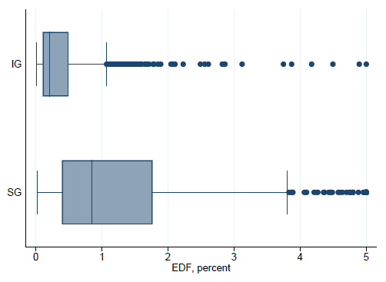
Credit lines typically not as risky as term loans
Lines have shorter maturities. Lines are larger than loans.
Lines are not as risky as loans… still a long right tail.
For lines, the cut-off for IG quality is at EDF of 1 pct.

Slide 7
Banks protect themselves against a drawdown shock
Borrowers are more likely to draw on lines when their situation deteriorates.
Borrower’s option to draw on the line exposes the banks to liquidity and capital shocks.
Banks may be stuck with high-risk on-balance-sheet exposures for quite some time.
Berg, Saunders, and Steffen (2016):
Loan pricing correlated with ex post usage of lines.
Borrowers that pay a lower spread on an undrawn portion of the line but a higher spread on a drawn portion of the line are less likely to draw on their line.

Slide 8
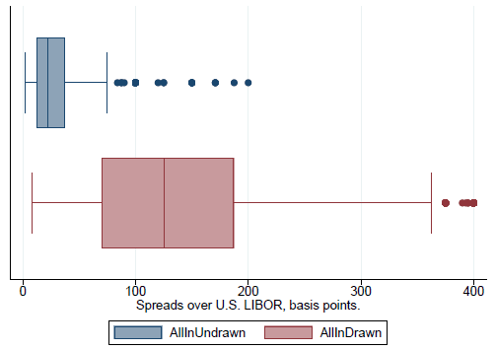
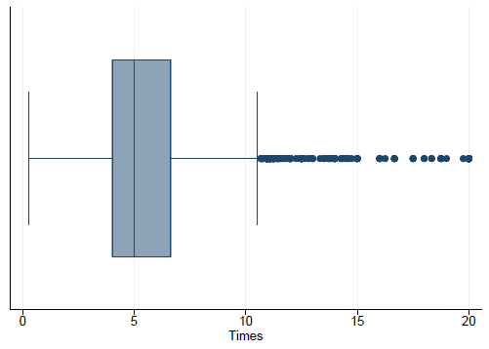
Ratios to gauge likelihood of drawdowns
Enormous differences in spreads on undrawn and drawn portions of lines.
Ratios of the spreads (proxies of unlikely draws (UD)) have a median of 5x and a long right tail.
Spreads
Ratio of spreads (UD)

Slide 9
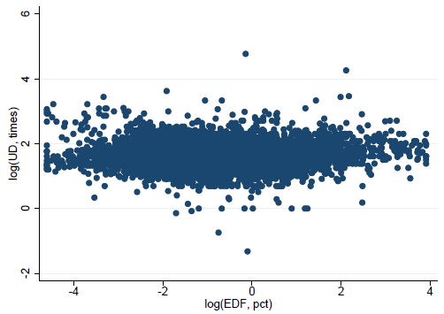
Unlikely-to-draw ratios not about credit risk
Both undrawn and drawn spreads reflect ex ante borrower credit risk.
UDs are not about credit risk, but about discouraging drawdowns.

Slide 10
Regression model
Refer to a bank’s stake in a syndicated line as “a line”.
LHS: $ line of bank l in syndicate j made to borrower b.
RHS: Risk-taking channel of monetary policy = Interactions of EDF with R and of EDF and UD with R.
Demand: Borrower-time fixed effects.
Supply: Bank-time fixed effects.
Past relationships: Bank-borrower fixed effects.
Caveats: Substantial data requirements; intensive margin only; Determinants of UDs not modeled.

Slide 11
Hypotheses
Work off the literature on a risk-taking channel that operates through originations of term loans and Berg, Saunders, and Steffen (2016).
Risk-taking channel that operates through originations of credit lines:
For a SG borrower, log(EDF) > 0 | Term loans | Credit lines
θ_{ER} × log(EDF) | Lower rates, larger riskier loans: θ_{ER} < 0 | Naively, θ_{ER} < 0 too?
θ_{EUR} × log(UD) × log(EDF) | Not applicable, disbursed at origination | Intuitively, θ_{EUR} < 0?
Overall effect | < 0 | < 0?

Slide 12
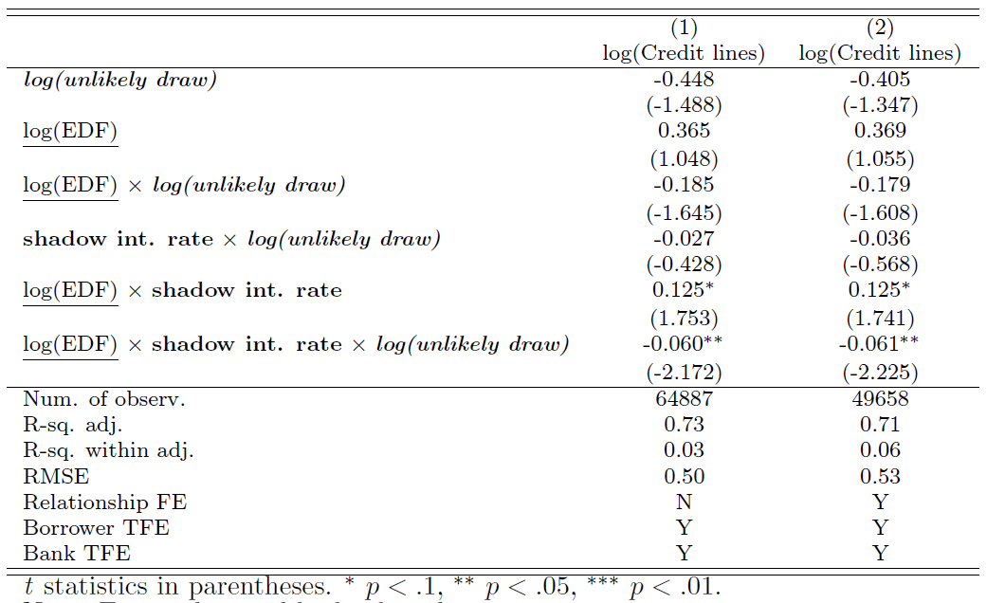
Different risk-taking chaneel than that for term loans
Lower rates ⇒ larger lines to the riskiest borrowers | pricing to discourage usage.
Overall effect of risk-taking channel

Slide 13
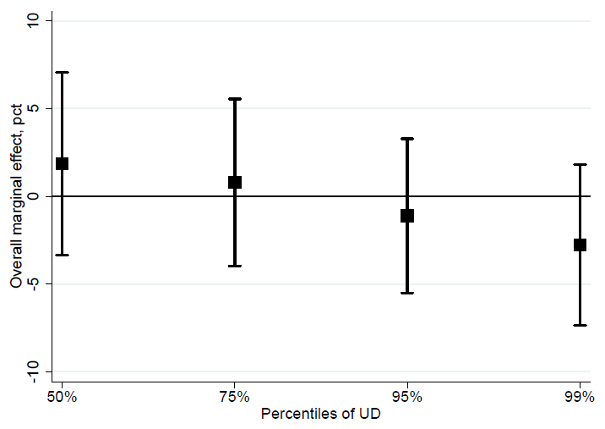
Very unlikely drawdowns are key for risk-taking
Non-linear model, marginal effects at reference points.
It is all about tails of UDs and EDFs.
All in all, no risk-taking? Wait, there is more!

Slide 14
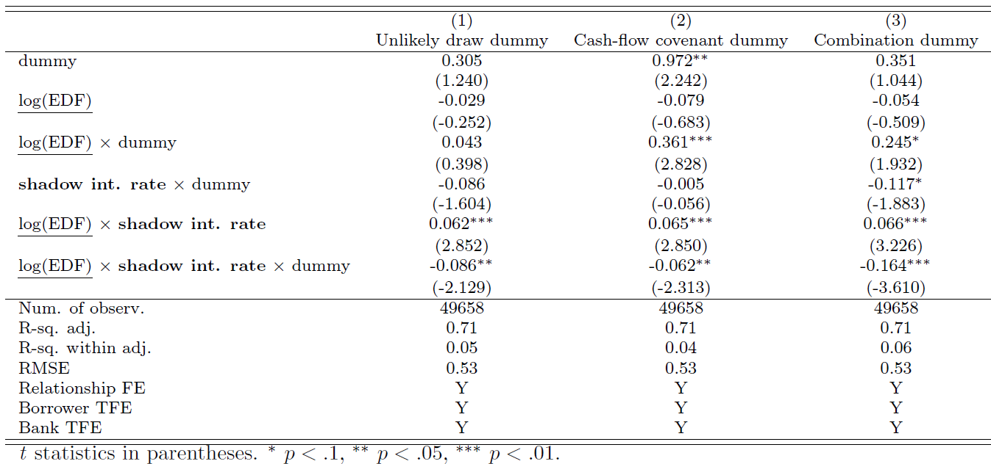
Other ways to reduce likelihood of drawdowns
Cash-flow covenants (CFs) require the borrowers to maintain ample cash.
Dummy for high UDs, a dummy for CFs, and a UD-CF combination dummy.
Two-prong “protection” from drawdowns strengthens the channel (col. 3).

Slide 15
Some bank characteristics amplify, others mitigate
Importance of bank characteristics.
Powers of bank supervision and degree of bank financial statement transparency from Barth, Caprio, and Levine’s surveys.
Channel stability: The channel operated before the GFC but it has weakened since.
Speculatively: Banks learned from the GFC, post-GFC regulatory and supervisory changes.
More risk-taking | Less risk-taking
Foreign banks | More powerful bank supervision
 | More transparent bank financial statements
(Tentative) Banks with more internal liquidity | (Tentative) Better capitalized banks

Slide 16
Conclusions
Banks appreciate the regularity that borrowers are more likely to draw on the lines when they are in difficulty.
Risk-taking channel operates only through originations of risky credit lines that are ex ante least likely to be drawn.
Some banks exposed to such lines might not handle mass drawdowns in a stress episode.
With bets on lines to remain undrawn going wrong, the capacity of these banks to be liquidity providers could weaken more than that of the others.
Not focusing on the risk of existing lines: In the pandemic, b/c of drawdowns, cutbacks in loan supply, redistribution of credit from small to large firms (Greenwald, Krainer, and Paul, 2020 & Kapan and Minoiu, 2021).

