Slide 1
Do Buffer requirements for European systemically important banks make them less systemic?
Luis Fernández Lafuerza, joint work with Carmen Broto and Mariya Melnychuk, Banco de España
2023 RiskLab/BoF/ESRB Conference on Systemic Risk Analytics
Bank of Finland, Helsinki
9/6/2023
The views represented here do not necessarily reflect those of Banco de España or the Eurosystem

Slide 2
OUTLINE
Introduction
How do we measure systemic risk of SIIs? SRISK
Methodological approach
Dataset
Main results
Conclusions

Slide 3
introduction
The Financial Crisis of 2007-2009 made systemic risk a central topic of research and policy
Two dimensions of systemic risk: cyclical and structural
  Cyclical – evolution of risks over time
  Structural – “Too Big to Fail” problem posed by systemically important institutions (SII)

Slide 4
introduction
The Financial Crisis of 2007-2009 made systemic risk a central topic of research and policy
Two dimensions of systemic risk: cyclical and structural
  Cyclical – evolution of risks over time
  Structural – “Too Big to Fail” problem posed by systemically important institutions (SII)
SII buffers mitigate risks posed by these institutions: G-SII and O-SII
  Objective of SII buffers:
    Increase loss absorption capacity
    Reduce moral hazard incentives
    Limit negative externalities to the financial system
  SII criteria (BCBS 2011, 2012): (1) size; (1) importance; (3) complexity; (4) cross-border; (5) interconnectedness.

Slide 5
introduction
Are these SII buffers really able to reduce the systemic risk of entities?
Previous related literature has been focused on
Effect of countercyclical capital buffer (CCyB) on credit supply: Drehmann and Gambacorta (2012); Aiyar et al. (2014, 2016); Jimenez and Saurina (2017)
Effect of O-SII buffer on lending [Cappelletti et al. (2019), Reghezza et al. (2020)] , CET1 ratio [Dautović (2020)] , and CDS spreads [Andries et al. (2020), Gündüz (2020)]
Effect of higher capital requirements on systemic risk: Bostandzic et al. (2021), Dautović (2020)
…Scarce evidence and somewhat contradictory

Slide 6
introduction
The objective of this paper:
  Investigate whether imposing higher capital buffers on G-SIB or O-SII reduce their contribution to the systemic risk for a sample of European banks
  Analyze what are the adjustment mechanisms for this

Slide 7
introduction
The objective of this paper:
  Investigate whether imposing higher capital buffers on G-SIB or O-SII reduce their contribution to the systemic risk for a sample of European banks
  Analyze what are the adjustment mechanisms for this
  Main results:
  SII buffers do decrease the systemic risk of European banks in the medium term
  Increase in equity appears as an important chanel

Slide 8
How do we measure systemic risk of SII?
Market based - systemic risk measures
Systemic risk is multidimensional and difficult to capture in a unique, compact framework (Hansen, 2014)
Several measures explore the systemic importance of individual institutions:
Purely market-based indicators:
  VaR Adams et al. (2014); White et al. (2015)
  ΔCoVaR Adrian and Brunnermeier (2016); Castro and Ferrari (2014)
Market + balance sheet information:
  SRISK Acharya et al. (2012); Brownlees and Engle (2017)
  SES Acharya et al. (2017)

Slide 9
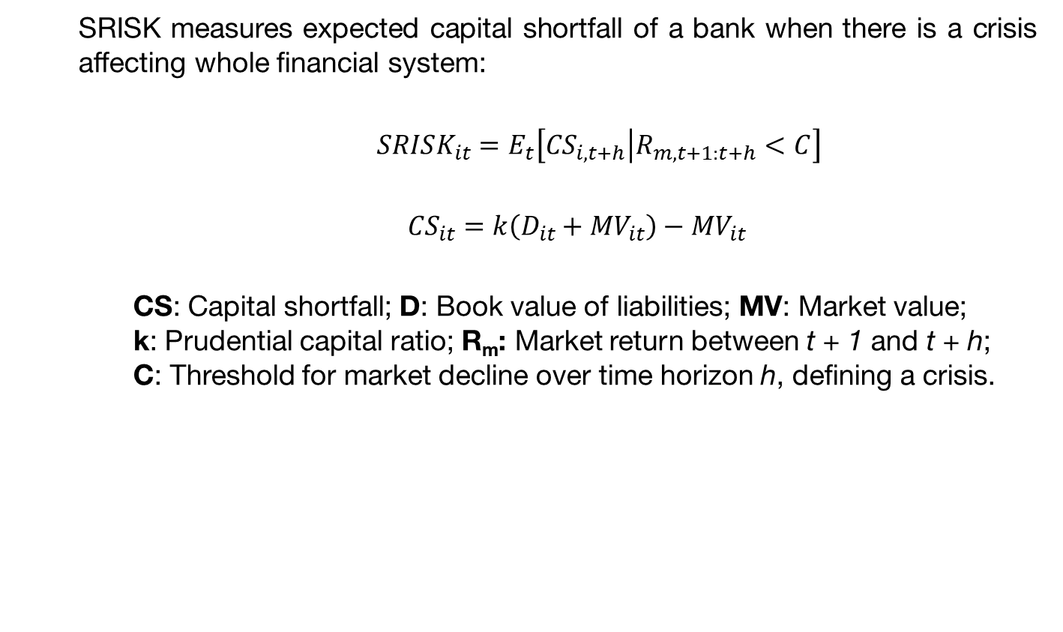
How do we measure systemic risk of SII?
SRISK (Brownless and Engle, 2017)
  SRISK measures expected capital shortfall of a bank when there is a crisis affecting whole financial system:
  $SRISK_{it}=E_{t}\left[\left.{CS}_{i,t+h}\right|R_{m,t+1:t+h}<C\right]$
  ${CS}_{it}=k\left(D_{it}+{MV}_{it}\right)−{MV}_{it}$
    CS: Capital shortfall; D: Book value of liabilities; MV: Market value; k: Prudential capital ratio; R_{m}: Market return between t + 1 and t + h; C: Threshold for market decline over time horizon h, defining a crisis.

Slide 10
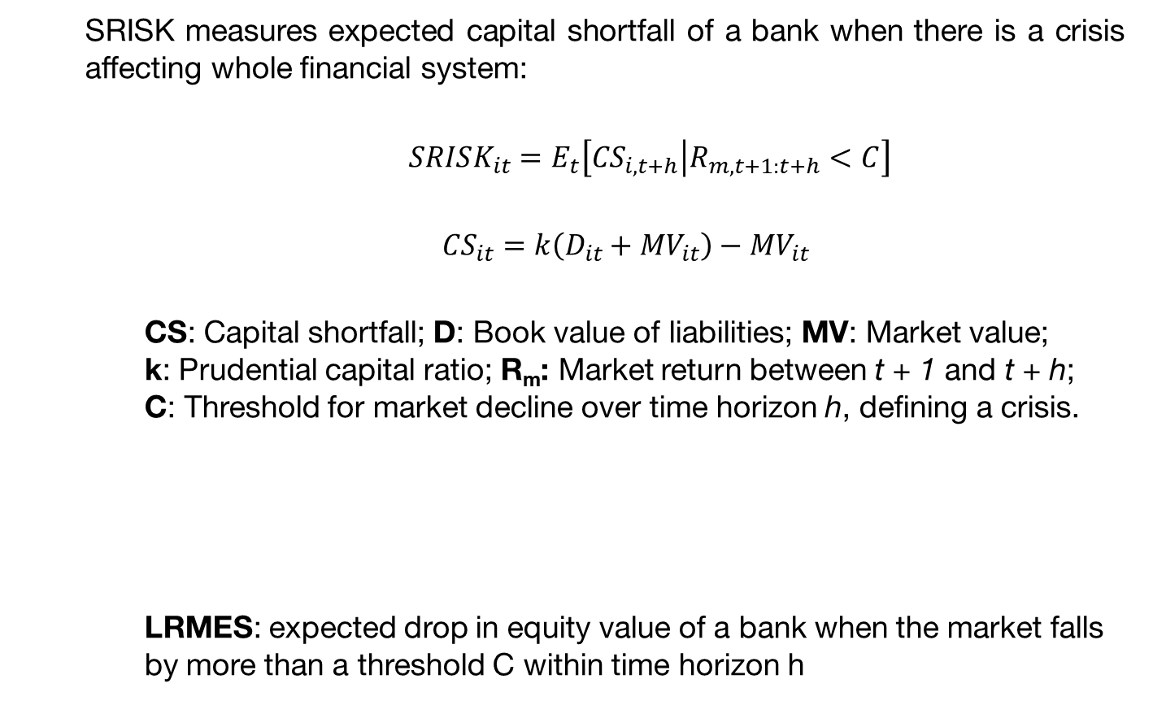
How do we measure systemic risk of SII?
SRISK (Brownless and Engle, 2017)
  SRISK measures expected capital shortfall of a bank when there is a crisis affecting whole financial system:
  $SRISK_{it}=E_{t}\left[\left.{CS}_{i,t+h}\right|R_{m,t+1:t+h}<C\right]$
  ${CS}_{it}=k\left(D_{it}+{MV}_{it}\right)−{MV}_{it}$
    CS: Capital shortfall; D: Book value of liabilities; MV: Market value; k: Prudential capital ratio; R_{m}: Market return between t + 1 and t + h; C: Threshold for market decline over time horizon h, defining a crisis.
    LRMES: expected drop in equity value of a bank when the market falls by more than a threshold C within time horizon h
${ SRISK}_{it}={k(D}_{it}+{MV}_{it}(1−{LRMES}_{it}))−{MV}_{it}\left(1−{LRMES}_{it}\right)$
Required capital
Available capital

Slide 11
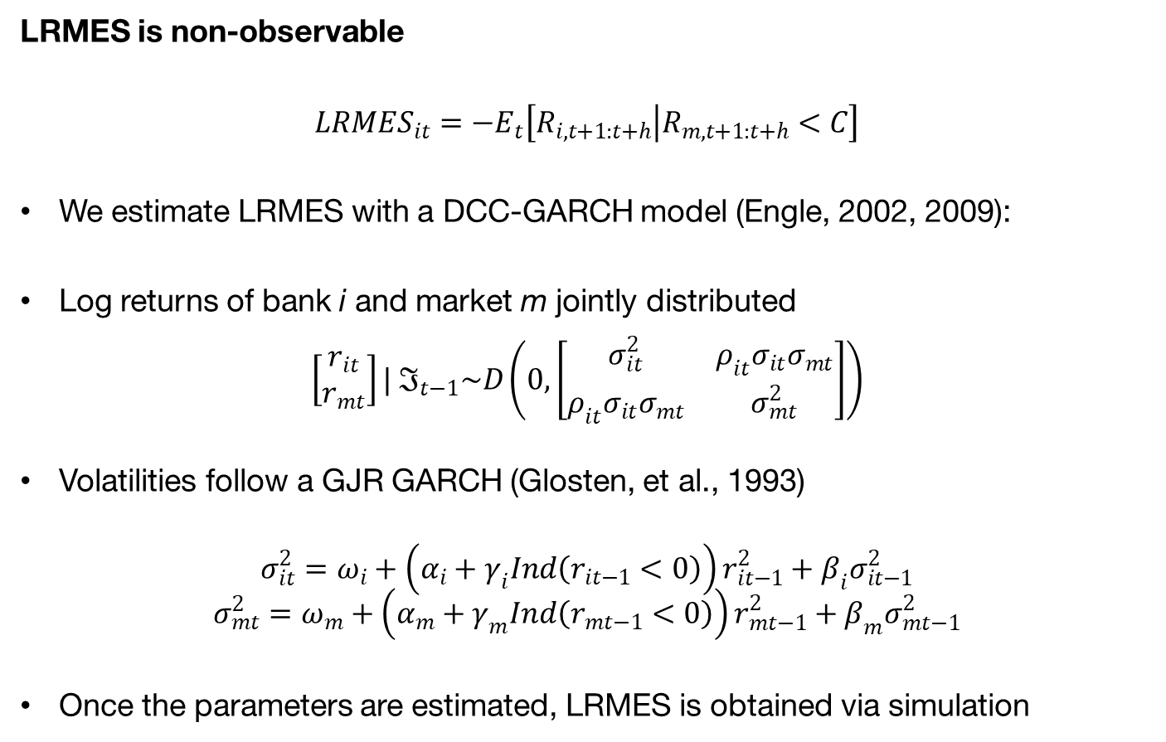
How do we measure systemic risk of SII?
Estimation of LRMES
LRMES is non-observable
$${LRMES}_{it}={−E}_{t}\left[\left.R_{i,t+1:t+h}\right|R_{m,t+1:t+h}<C\right]$$
We estimate LRMES with a DCC-GARCH model (Engle, 2002, 2009):
Log returns of bank i and market m jointly distributed
$$\left[\begin{matrix}r_{it} \\ r_{mt}\end{matrix}\right]| ℑ_{t−1}\sim D\left(0,\left[\begin{matrix}σ_{it}^{2} & ρ_{it}σ_{it}σ_{mt} \\ ρ_{it}σ_{it}σ_{mt} & σ_{mt}^{2}\end{matrix}\right]\right)$$
Volatilities follow a GJR GARCH (Glosten, et al., 1993)
$$σ_{it}^{2}=ω_{i}+\left(α_{i}+γ_{i}Ind\left(r_{it−1}<0\right)\right)r_{it−1}^{2}+β_{i}σ_{it−1}^{2}$$
$$σ_{mt}^{2}=ω_{m}+\left(α_{m}+γ_{m}Ind\left(r_{mt−1}<0\right)\right)r_{mt−1}^{2}+β_{m}σ_{mt−1}^{2}$$
Once the parameters are estimated, LRMES is obtained via simulation

Slide 12
How do we measure systemic risk of SII?
Estimation of LRMES
LRMES is non-observable
$${LRMES}_{it}={−E}_{t}\left[\left.R_{i,t+1:t+h}\right|R_{m,t+1:t+h}<C\right]$$
We estimate LRMES with a DCC-GARCH model (Engle, 2002, 2009):
Log returns of bank i and market m jointly distributed
$$\left[\begin{matrix}r_{it} \\ r_{mt}\end{matrix}\right]| ℑ_{t−1}\sim D\left(0,\left[\begin{matrix}σ_{it}^{2} & ρ_{it}σ_{it}σ_{mt} \\ ρ_{it}σ_{it}σ_{mt} & σ_{mt}^{2}\end{matrix}\right]\right)$$
Volatilities follow a GJR GARCH (Glosten, et al., 1993)
$$σ_{it}^{2}=ω_{i}+\left(α_{i}+γ_{i}Ind\left(r_{it−1}<0\right)\right)r_{it−1}^{2}+β_{i}σ_{it−1}^{2}$$
$$σ_{mt}^{2}=ω_{m}+\left(α_{m}+γ_{m}Ind\left(r_{mt−1}<0\right)\right)r_{mt−1}^{2}+β_{m}σ_{mt−1}^{2}$$
Once the parameters are estimated, LRMES is obtained via simulation
Is LRMES estimation any good?

Slide 13
How do we measure systemic risk of SII?
SRISK: Advantages and limitations
Advantages of SRISK:
  Captures key dimension relevant for systemic risk: leverage and interconnectedness
  Publicly available data: Relatively inexpensive and quick to compute
  High frequency data: Sudden shifts in systemic risk can be quickly detected
  It could be interpreted as forward-looking (through market value)

Slide 14
How do we measure systemic risk of SII?
SRISK: Advantages and limitations
Advantages of SRISK:
  Captures key dimension relevant for systemic risk: leverage and interconnectedness
  Publicly available data: Relatively inexpensive and quick to compute
  High frequency data: Sudden shifts in systemic risk can be quickly detected
  It could be interpreted as forward-looking (through market value)
Limitations of SRISK:
  Based on market data: Only available for listed institutions
  Reflects markets’ perception: a decline in the market value of equity may be an adverse signal, but it does not necessarily imply a subsequent capital shortage or insolvency. Not a fully fledged stress test.
Increasing use by institutions: NYU V-Lab, Banque de France, Banque du Canada, Danmarks Nationalbank, De Nederlandsche Bank…

Slide 15
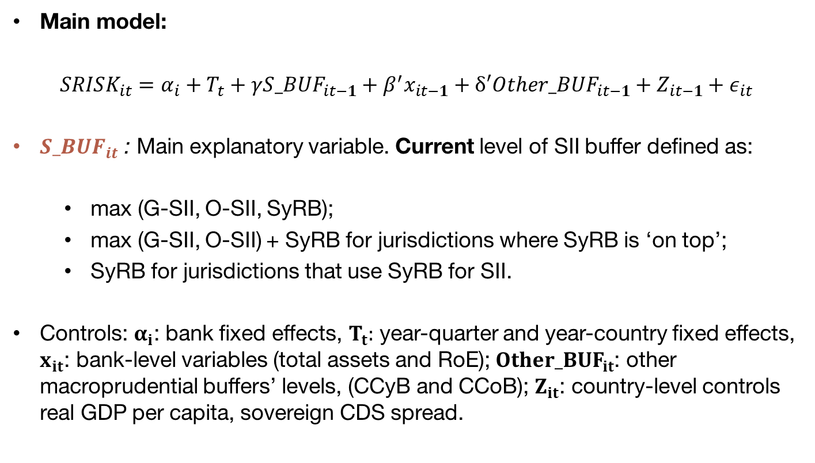
Methodological approach
Our model
Main model:
$$SRISK_{it}=α_{i}+T_{t}+γ{S_BUF}_{it−1}+β^{′}x_{it−1}+δ′{Other_BUF}_{it−1}+Z_{it−1}+ε_{it}$$
${S_BUF}_{it}$ : Main explanatory variable. Current level of SII buffer defined as:
  max (G-SII, O-SII, SyRB);
  max (G-SII, O-SII) + SyRB for jurisdictions where SyRB is ‘on top’;
  SyRB for jurisdictions that use SyRB for SII.
Controls: $α_{i}$: bank fixed effects, $T_{t}:$ year-quarter and year-country fixed effects, $x_{it}$: bank-level variables (total assets and RoE); ${Other_BUF}_{it}$: other macroprudential buffers’ levels, (CCyB and CCoB); $Z_{it}$: country-level controls real GDP per capita, sovereign CDS spread.

Slide 16

Methodological approach
Alternative main explanatory variables
Alternative specifications based on dummy variables
SII status variable ${SII_STAT}_{it} \text{defined} \text{as}$
$${SII_STAT}_{it}=\left\{\begin{matrix}1 & if designated SII by EBA or FSB in t \\ 0 & otherwise\end{matrix}\right.$$
SII signalling variables (1) ${SII_IN}_{it}$ and (2) ${SII_OUT}_{it}$ defined as
$${SII_IN}_{it}=\left\{\begin{matrix}1 & if {SII_STAT}_{it}≠0 and {SII_STAT}_{it−1}=0 \\ 0 & otherwise\end{matrix}\right.$$
$${SII_OUT}_{it}=\left\{\begin{matrix}1 & if{ SII_STAT}_{it}=0 and {SII_STAT}_{it−1}≠0 \\ 0 & otherwise\end{matrix}\right.$$

Slide 17
The dataset
Sample period: Q1 2008 – Q3 2021
Sample: 170 banks over 25 EU countries
  All publicly traded European banks included in Thomson Reuters Financial Datastream – about 80% of total EU bank assets
Data sources:
  SRISK: Market data from DS and balance sheet data from SNL Financial
  Buffer requirements: European Systemic Risk Board (ESRB)
  G-SIIs classification: Financial Stability Board (FSB)
  O-SIIs classification: European Banking Authority (EBA)
  Equity issuance: Dealogic
  GDP: Eurostat

Slide 18
Main results
Strong negative association between SII buffer level and SRISK pre-Covid

Slide 19
Main results
Strong negatie association between SII status and SRISK pre-Covid

Slide 20
Main results
Strong positive association between SII designation and SRISK pre-Covid

Slide 21
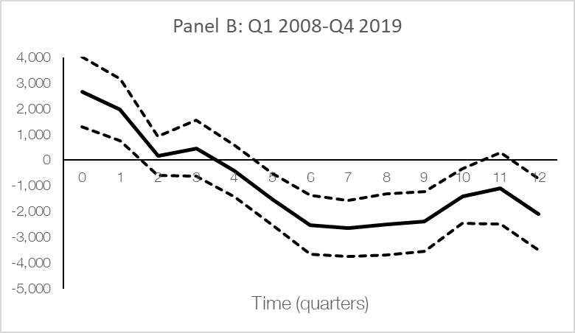
Main results
SII announcement: Associated with lower SRISK only in the short term
We explore the effect of being identified as SII over time via local projections
$$SRISK_{it+q}=α_{i}^{q}+T_{t}^{q}+β^{q′}x_{it−1}+γ^{q}{SII_IN}_{it−1}+ε_{it+q}$$
IMPULSE-RESPONSE FUNCTIONS OF SII ANNOUNCEMENT, CALCULATED VIA LOCAL PROJECTIONS
Dashed lines: 95% confidence interval, clustered at bank level.

Slide 22
Main results
Adjustment channels
Main adjustment channels to higher capital requirements (Cohen and Scatigna 2016):
  Increase total equity:
    retain earnings (e.g. by reducing dividend policy)
    issue new shares
  Reduce risk-weighted assets
Each option is costly:
  New share issuance could reduce the market value of existing shares (Eckbo et al (2007), Cohen et al. (2016))
  Reduce the proportion of risky assets or replacing them with low-risk weights ones could decrease profitability (Bostandzic et al., 2021)

Slide 23
Main results
Adjustment channels
The buffer level is associated with higher equity, retained earnings and equity issuances, but not average risk-weight density

Slide 24
Main results
Adjustment channels
Once we control for the main channels, the impact of S_Buf decreases
Total Equity appears to be an adjustment channel

Slide 25
Main results
Adjustment channels
Once we control for the main channels, the impact of S_Buf decreases
Total Equity appears to be an adjustment channel
Retained earnings dominates the effect of total equity on SRISK

Slide 26
CONCLUSIONs
We find a negative link between the SII buffer level and SRISK
SII status itself also associated with lower systemic risk, regardless the buffer level
Being designated SII is associated with increased SRISK in the sort term, but association declines and reverses in the medium term

Slide 27
CONCLUSIONs
We find a negative link between the SII buffer level and SRISK
SII status itself also associated with lower systemic risk, regardless the buffer level
Being designated SII is associated with increased SRISK in the sort term, but association declines and reverses in the medium term
The impact of the buffer level on SRISK decreases once we control for total equity, which indicates that banks respond to higher buffers increasing their equity, as intended
The effects found are economically significant and indicate that the SII frameworks have been effective in decreasing systemic risk

Slide 28
Thank you for your attention!

Slide 29
How do we measure systemic risk of SII?
SRISK: An illustration for European listed banks
SOURCES: Datastream, SNL y Banco de España.
Parameters: k=4.5%; C=10%; h=1 month (22 trading days); Stock prices index: STOXX Europe 600.
Notes:
Changes in the SRISK of European listed banks since March 2020, coinciding with the spread of COVID-19, pushed the indicator close to the peak levels observed during the 2012 European sovereign debt crisis and above the levels of the 2008-2009 global financial crisis
As from November 2020, this indicator has clearly decreased, in line with the favorable performance of financial markets, although it clearly remains above pre-crisis levels.

Slide 30
Descriptive statistics

Slide 31
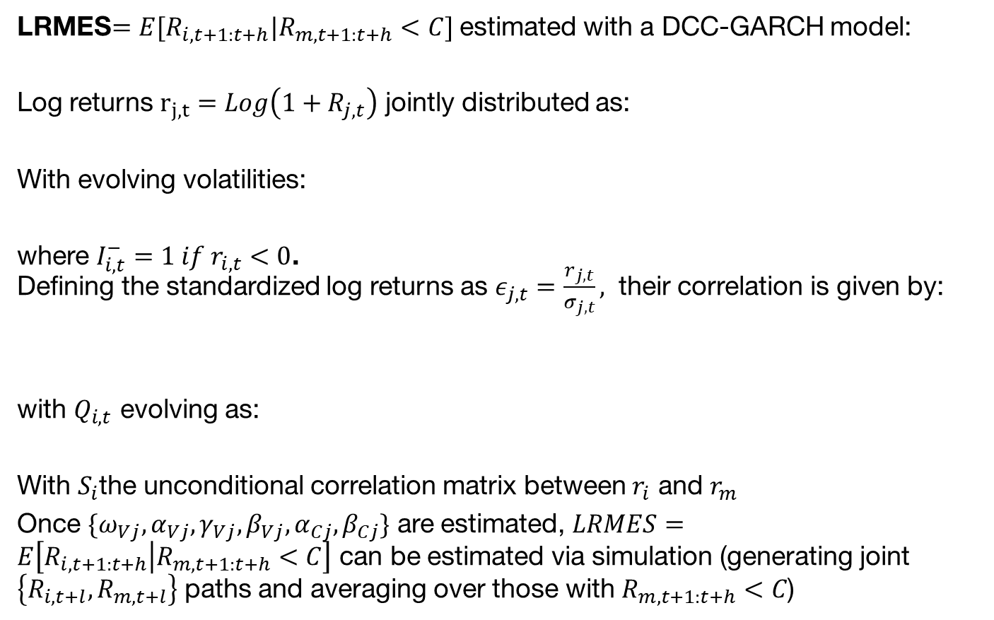
How do we measure systemic risk of SII?
Estimation of LRMES
LRMES$=E[R_{i,t+1:t+h}|R_{m,t+1:t+h}<C]$ estimated with a DCC-GARCH model:
Log returns $r_{j,t}=Log\left(1+R_{j,t}\right)$ jointly distributed as:
With evolving volatilities:
where $I_{i,t}^{−}=1 if r_{i,t}<0$.
Defining the standardized log returns as $ε_{j,t}=\frac{r_{j,t}}{σ_{j,t}},$ their correlation is given by:
with $Q_{i,t}$ evolving as:
With $S_{i}$the unconditional correlation matrix between $r_{i}$ and $r_{m}$
Once $\{ω_{Vj}, α_{Vj},γ_{Vj}, β_{Vj}, α_{Cj}, β_{Cj}\}$ are estimated, $LRMES=E\left[R_{i,t+1:t+h} | R_{m,t+1:t+h}<C\right]$ can be estimated via simulation (generating joint $\left\{R_{i,t+l},R_{m,t+l}\right\}$ paths and averaging over those with $R_{m,t+1:t+h}<C$)

Slide 32
Specification in logs
Results similar to specification in levels, somewhat less significant (observations with SRIS<0 cannot be included)
1 pp increase in SII buffer, 14% decrease in SRISK

Slide 33
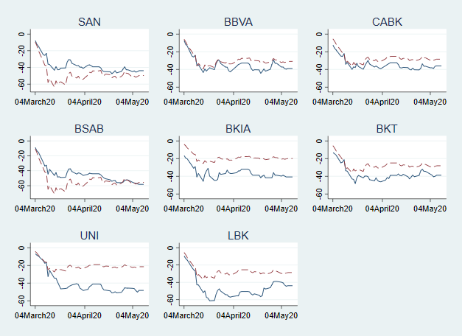
Bank retunrs during the Covid Shock are reasonably in line with LRMES predictions
During the COVID shock the stock market fell sharply
Does LRMES, calculated with data up until end of January 2020, and assuming
a 10% drop in one month, capture the price fall in individual banks?
LRMES captures well the price fall of large Banks
Even beyond the assumed 10% fall in 1 month
Not so accurate for smaller banks
Back
Market value drops from Feb 2020 to June 2020, actual (solid blue) and predicted by LRMES (dashed red)

