Slide 1
Bank of Finland Bulletin 2/2014: Financial stability
Pentti Hakkarainen, Deputy Governor

Slide 2
Themes of the stability report
Owing to the weak outlook for the real economy, particular attention needs to be devoted to the vulnerabilities of the domestic financial system.
Risks can be created by: housing price developments and households’ considerable debt levels, effects of low interest rates and transmission of bank lending.
As demonstrated by the financial crisis, Finland also needs internationally comparable instruments for prevention of systemic risks.
Banking union marks an important step forward. Supervision and resolution should be on the same cross-border level as the actual operations of financial institutions.

Slide 3
Risks related to economic and credit cycles

Slide 4
Improved access to finance supports euro area’s gradual recovery from the crisis

Slide 5
Increased risk appetite may distort prices on securities markets

Slide 6
Share prices on the increase

Slide 7
Risks transmitted from abroad to Finland
The development of the international economy and financial markets has a great impact on the prospects and risks for the Finnish economy and financial system.
Risks of key concern for Finland:
Emergence of renewed instability on international financial markets.
Long-sustained low level of interest rates and excessive rise in asset prices.
Impact of geopolitical tensions on the Finnish economic outlook.

Slide 8
  Domestic economy, non-financial corporations, households, public finances

Slide 9
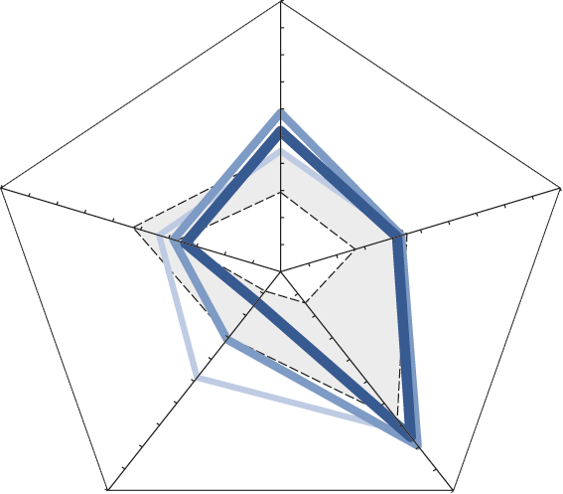
Indebtedness and development of the real economy pose the main risks to the Finnish financial system
Real economy
Banks’
viability
Housing
prices
Risk premia
Indebtedness
June 2012
June 2013
May 2014
The outer values reflect higher systemic risks.
Sources: NASDAQ OMX Helsinki, banks, Statistics Finland and Bank of Finland.

Slide 10
Growth rate of MFI corporate loans has remained subdued

Slide 11
Interest rates on corporate loan stock in euro area countries

Slide 12
Access to finance has remained good in the corporate sector in Finland

Slide 13
Bankruptcies increasing slightly, but still
at a moderate level

Slide 14
Household indebtedness continued to grow but at a slower pace

Slide 15
Half of household debts held by a tenth of households

Slide 16
Growth rate of housing loans has decelerated

Slide 17
Real housing prices have declined, regional differences in price developments

Slide 18
Financial system risk resilience and structural risks

Slide 19
Finnish banking sector’s risk resilience has remained good

Slide 20
Banking sector performance unchanged and loan losses small

Slide 21
Low interest rates and slower growth of lending stock strain profitability

Slide 22
Dependency on international wholesale funding increases vulnerability

Slide 23
Banking sector sensitive to contagion
Finnish banking sector’s degree of concentration among the highest in the EU.
Strong interconnectedness within the Nordic banking system. Large amount of assets in the Nordic countries, only small amount in the higher-risk countries.
Significant share of the Finnish banking sector in the ownership of Nordic parent banks.
Domestic banks’ foreign assets and liabilities have increased in the 2000s.

Slide 24
Insurance sector has maintained its solvency
Insurance sector profitability and solvency have remained good, but considerable differences between companies can be observed.
Insurance companies have been able to adjust their business models in the low interest rate environment.
Unexpected shocks in the investment market pose the main risk to profitability and solvency.

Slide 25
Infrastructure has operated reliably
A reliable infrastructure that functions under all circumstances is a key part of a stable financial system
  International cooperative oversight plays an important role
Fragmentation of functions can endanger continuity
  National contingency arrangements important
Finland migrated to SEPA on schedule, development continues
  New cooperation groups have been established: the Euro Retail Payments Board (ERPB) in Europe and the Payments Council in Finland

Slide 26
Measures to ensure financial stability

Slide 27
The macroprudential tools to be introduced in Finland
Countercyclical capital buffer requirement: 2015
Binding maximum loan-to-value (LTV) ratio for housing loand (loan-to-value cap): 7/2016
Minimum risk weights for housing loans: 2015
Additional capital requirement for domestic systemically important credit institutions (O-SII requirement): 2016

Slide 28
…. should be supplemented
Use of the systemic risk buffer should also be made possible in Finland
  Additional capital requirement permitted by the Capital Requirements Directive if the national banking sector is structurally vulnerable
  There should not be big differences in regulation and supervision in an integrated banking market
  Nearly all EU countries will incorporate the requirement in their legislation
An internationally comparable set of instruments is necessary; use of the instruments to be determined separately.

Slide 29
National additional capital requirements for systemically important credit institutions in the Nordic countries, maximum requirement

Slide 30
Banking union about to start
The two key elements of banking union – single supervision of banks and single resolution – are about to start.
The resolution mechanism and bail-in remove/reduce the costs of banking crises to taxpayers.
Also in Finland, resolution legislation and the related powers for authorities must be implemented promptly in all respects.

Slide 31
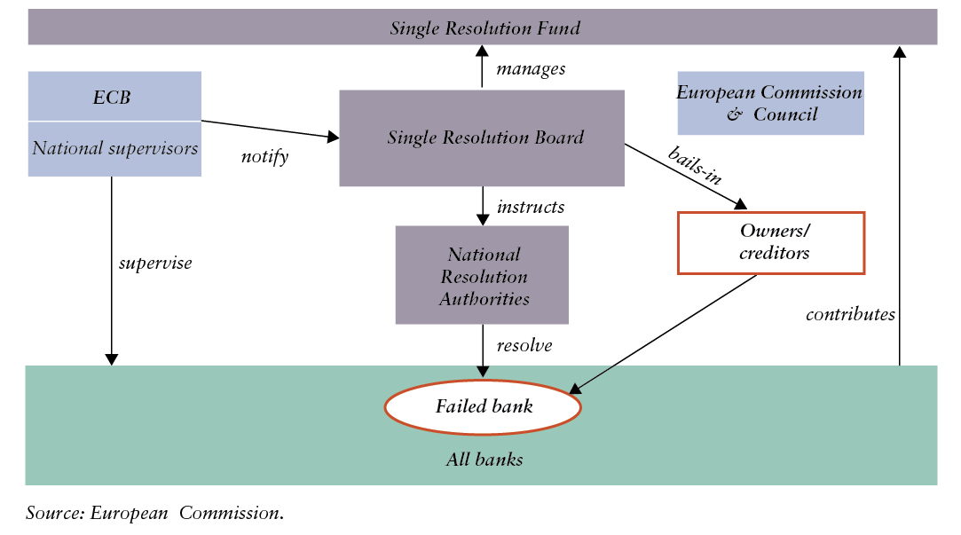
Single Resolution Mechanism

Slide 32
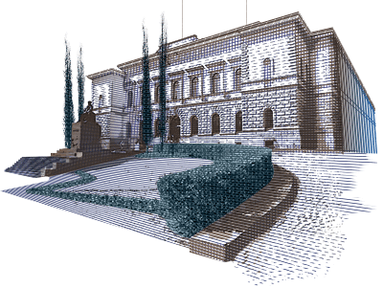
Thank you!

